Slide 1
Canadian Fire Weather Situation
Presented to the Canadian Interagency Forest Fire Centre (CIFFC)
June 25, 2025
Via Teams
Richard Carr / Liam Buchart
Canadian Forest Service
Wildland Fire Information Systems Group, Northern Forestry Centre

Slide 2
Instructions to developer
Linking Images:
Some images are linked to URLs and update automatically. Linking images can be done by using menu items <Insert> then <Pictures>, and specifying
the URL or network location in the <File name> box, and choosing <Insert>
then <Insert and link>, for example. The speaker notes on each slide indicate if images update automatically or need manual updates.
When you are done this presentation for the current day’s briefing:
Copy it to a presentation dated for your next briefing day
On the current day’s presentation
Go to the <File> menu
Under <Related Documents>, go to <Edit Links to File>
Select each file and choose <Break link to file>
This procedure ensures if you open an old presentation, the chosen images for that date are not overwritten by the automatic updates.
Drawing on images:
Epic Pen is a versatile tool we have used to draw on images. If Epic Pen is not installed, you may try the built-in Powerpoint pen, faintly visible in the lower left corner when in Presenter (full screen) mode. This offers pen and highlighter with color choices, but apparently no choice of line weight. Microsoft’s Snip & Sketch can also be used. It offers more options, including pen thicknesses, but operates on new pop-up windows created after snipping, so is a bit clumsier.
Notes:
2

Slide 3
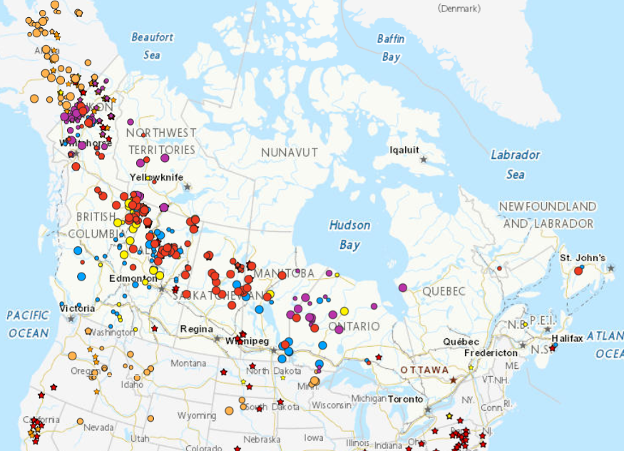
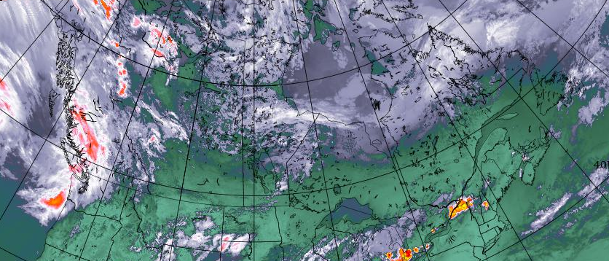
CWFIS Hotspots (Interactive Map)
http://cfsdev.nofc.cfs.nrcan.gc.ca/cwfis-dev/interactive-map
http://weather.gc.ca/data/satellite/goes_nam_1070x_100.jpg
Interactive map : ~14.5H x 22.8W 9Hx11.6W
Notes:
Update images manually. We want to preserve the images from the previous afternoon.
To overlay a semi-transparent satellite image:
-Align the red line from the northern tip of Vancouver Island to the southeast tip of Newfoundland’s Avalon Peninsula.
-Get the CWFIS interactive map image from late afternoon on Tuesday and align with the red line as above
-Choose the late afternoon Tuesday North American GOES composite image. Rotate ~7 degrees, transparency ~50%.
and align with the red line/CWFIS interactive map image.
Previous afternoon’s CWFIS active fire layer with other themes such as hotspots as you see fit. Red circles are fires of > 1000 ha, orange 100-1000 ha, yellow < 100 ha.
Include satellite image from Environment Canada (North American IR & topography) from about the same time as the CWFIS screenshots.
The inset shows fires in Yukon via the Data Integration Project. Red circles indicate uncontrolled fires.
3

Slide 4
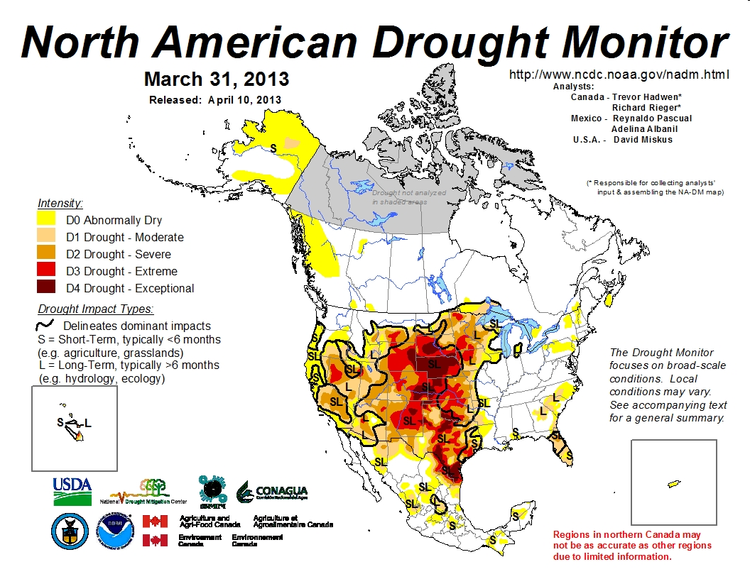
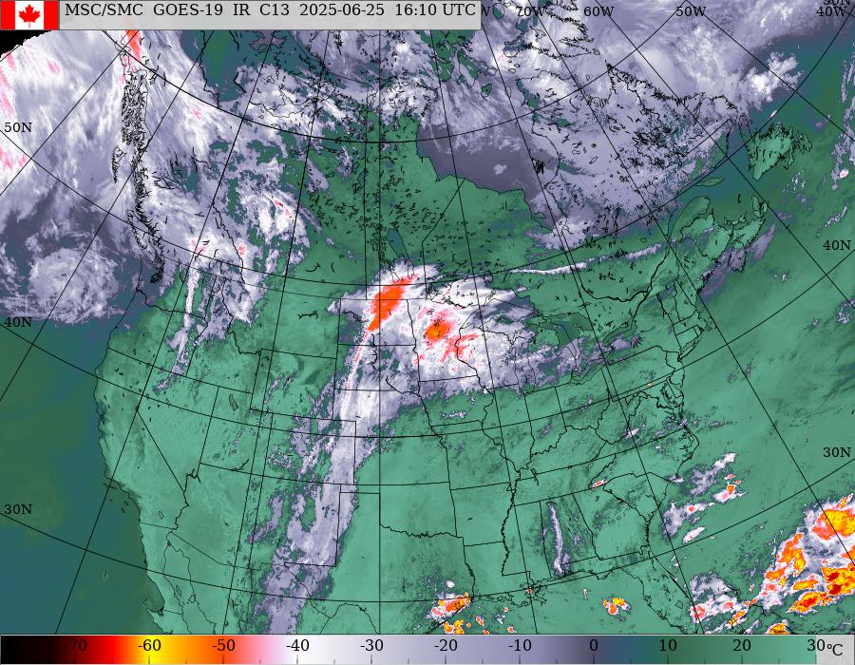
North American IR Composite
http://weather.gc.ca/data/satellite/goes_nam_1070_100.jpg
14H x 18W
Notes:
Image is updated automatically from web.

Slide 5
Water Vapor Imagery
College of Dupage (COD) water vapor loop
14H x 18W
Notes:
Image is updated automatically from web.

Slide 6
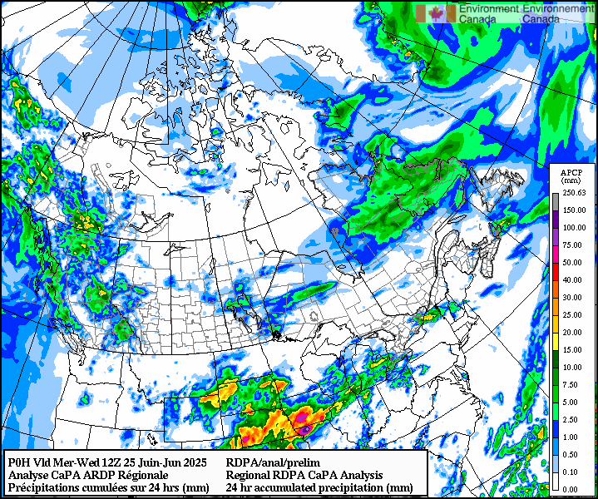
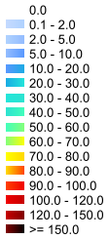
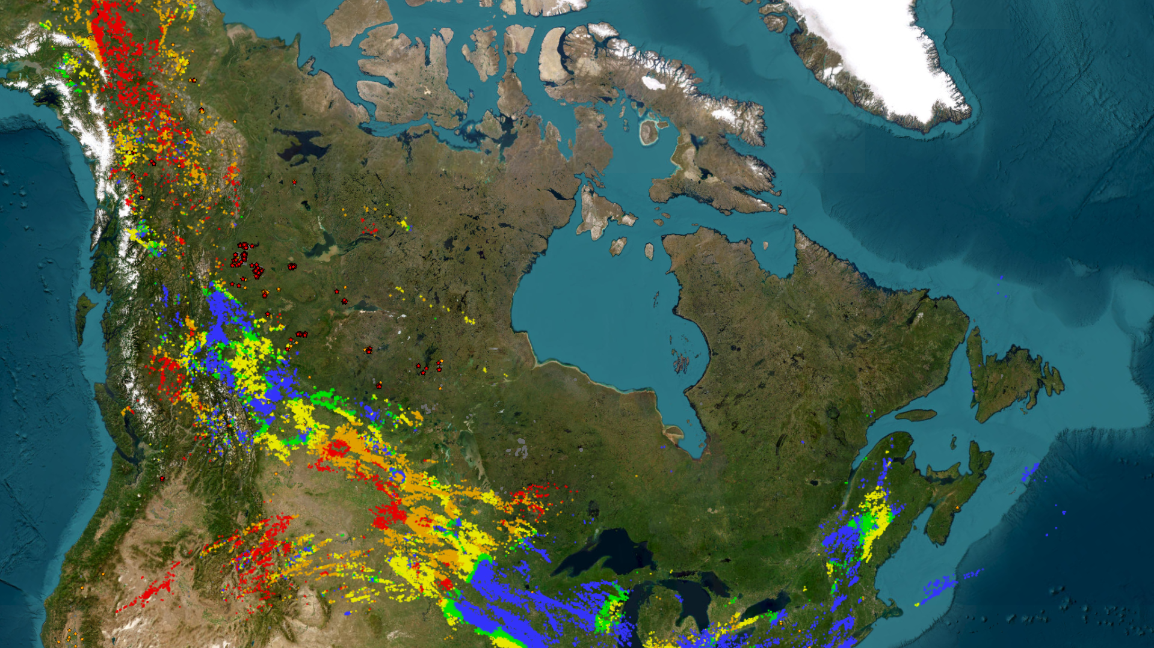
Lightning and CaPA
Local Repository: W:\EDM\Fire\CIFFC\WeatherBriefings\Gen_Image_Repo\capa_prelim1.png
MSC AniMet
CLDN past 48 hours
14Hx16.8W 6.9H x 12W
Notes:
Automatic update of CaPA image when downloaded using Markus’ tool.
We likely need to update the Ops Room Viewer image manually as layers have to be chosen. Use https://app-portal-cwfis-sbx.azurewebsites.net/situation-viewer
6

Slide 7
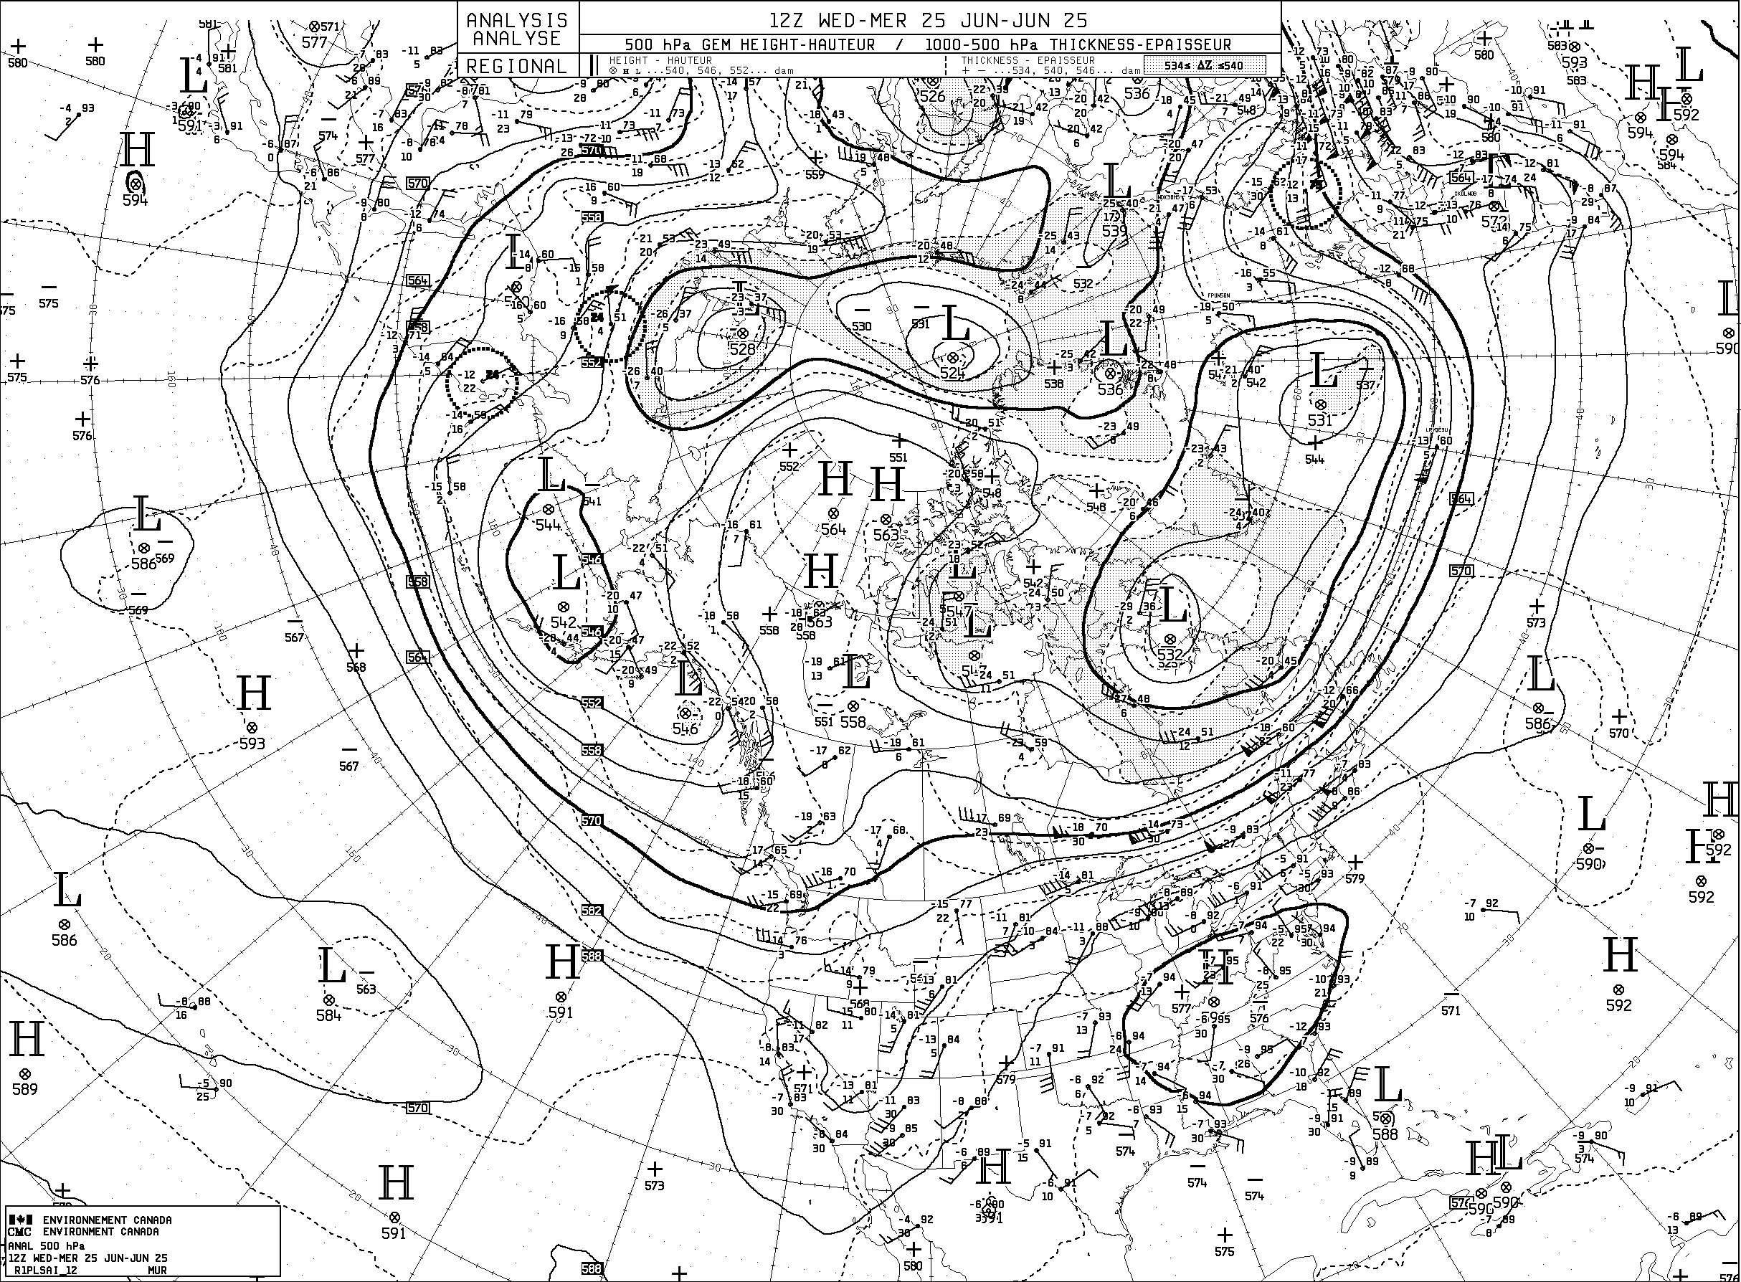
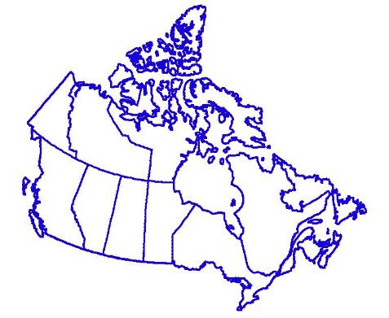
500 hPa Analysis (12 UTC)
250 hPa: https://weather.gc.ca/data/analysis/sah_100.gif
500 hPa: https://weather.gc.ca/data/analysis/sai_100.gif
L
H
H
L
L
L
L
L
L
L
H
H
H
H
L
14H x 19W
Notes:
Images are updated automatically from the web.
250 hPa analysis shows jet stream features (or lack thereof)
Point out major troughs and ridges and areas without significant features. The latter are often prone to fire if unchanged over a period of a few days or more.

Slide 8
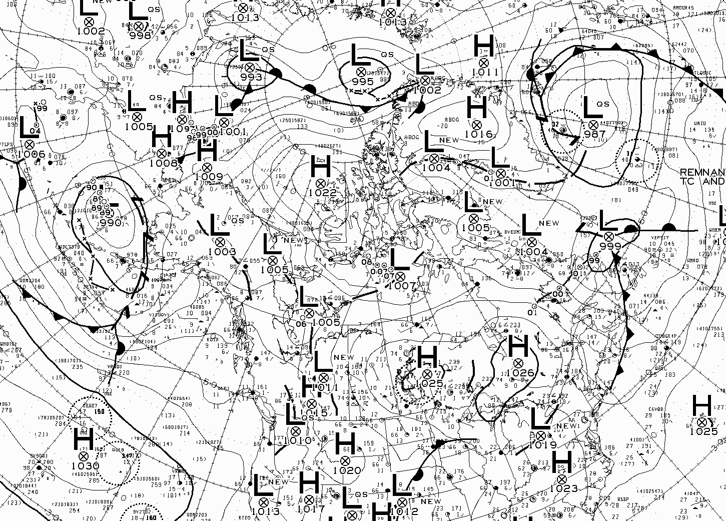
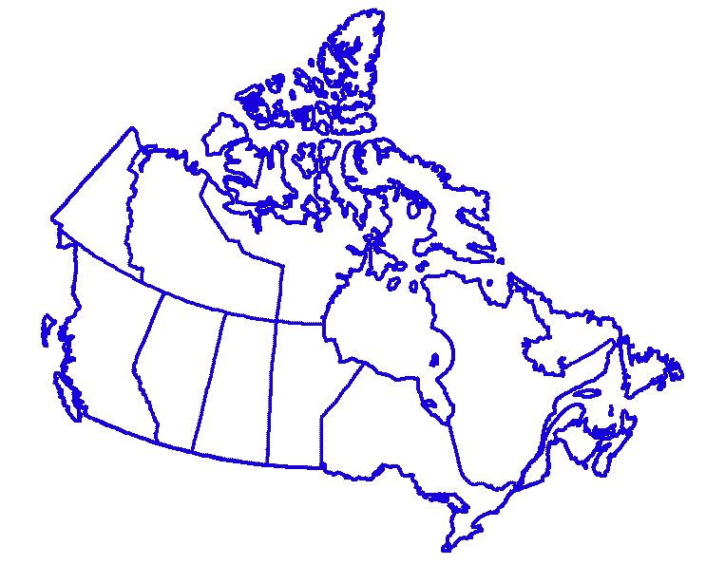
Surface Analysis (12 UTC)
http://weather.gc.ca/data/analysis/935_100.gif
15H x 17.5W
Notes:
Images are updated automatically from the web.
Morning (12Z) surface analysis for Canadian region showing surface pressure pattern (or lack thereof)
Point out major troughs and high pressure areas and areas without significant features.

Slide 9
Forecast conditions

Slide 10
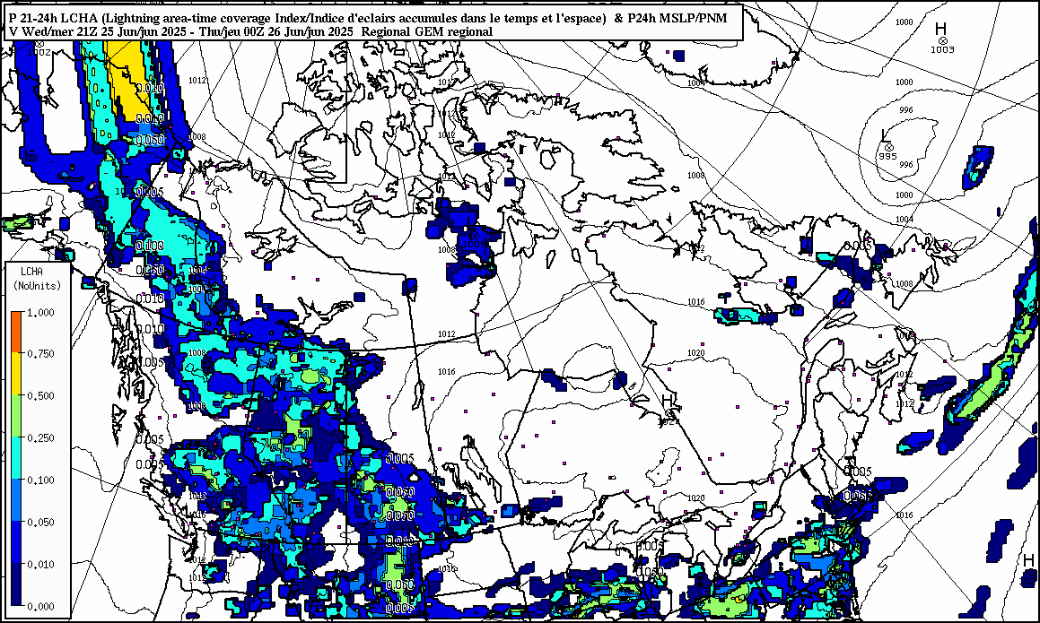
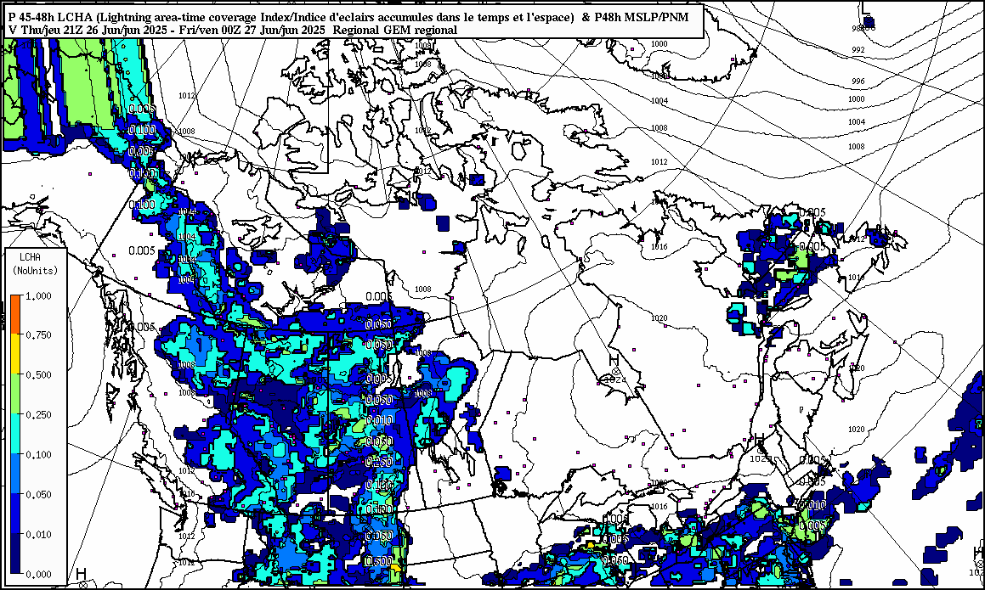
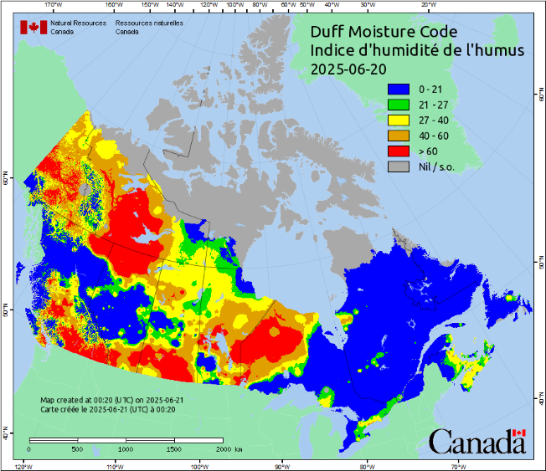
Lightning Forecast
https://hpfx.collab.science.gc.ca/~snlw001/billdata1/lightning_forecasts
Maps generated by Environment Canada –
Meteorological Service of Canada
Lightning area time coverage index
Thu pm
Wed pm
7.5H x 12.5W
Notes:
Update manually for now.
Short-term lightning forecast maps from Bill Burrows at EC-MSC’s Alberta/Arctic weather centre in Edmonton. These are uploaded to daily at about 11:00 am MDT, so we miss the morning update when doing most CIFFC briefings (except SPU, which runs at noon MDT). Normally use the 21 and 45 hour images, valid late afternoon today and tomorrow.

Slide 11
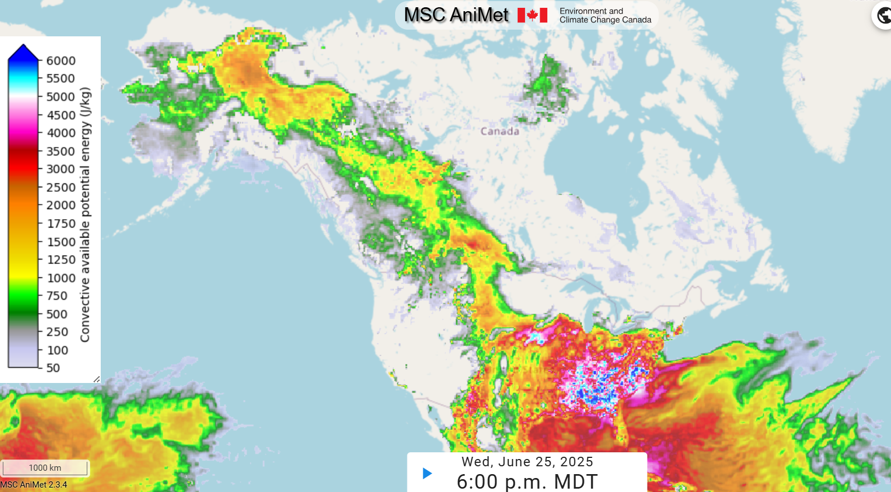
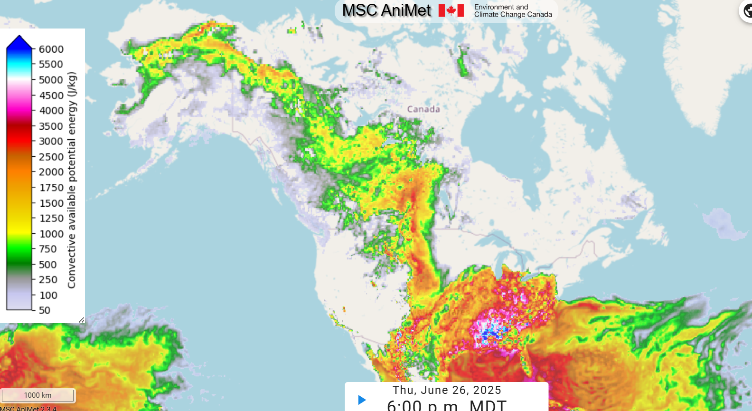
Lightning Forecast
\\s-bsc-uiftprd1.nrn.nrcan.gc.ca\incoming\burrows_ltg
Wed pm June 25 pm, Surface-based CAPE
Maps generated by Environment Canada –
Meteorological Service of Canada
Thu June 26 pm, Surface-based CAPE
7.5H x 12.5W
Notes:
Update manually for now.

Slide 12
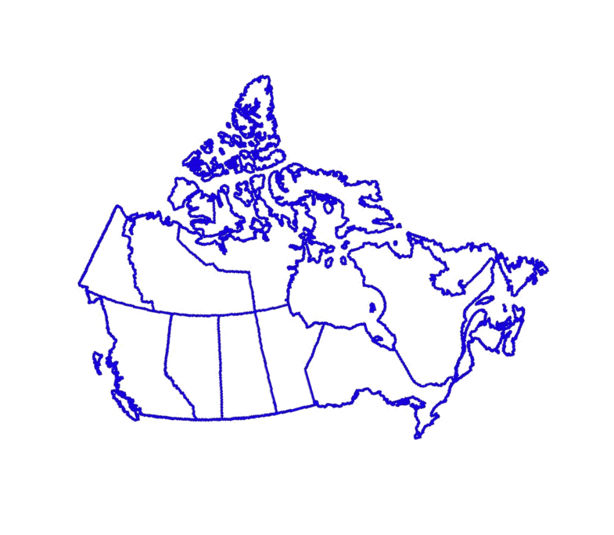
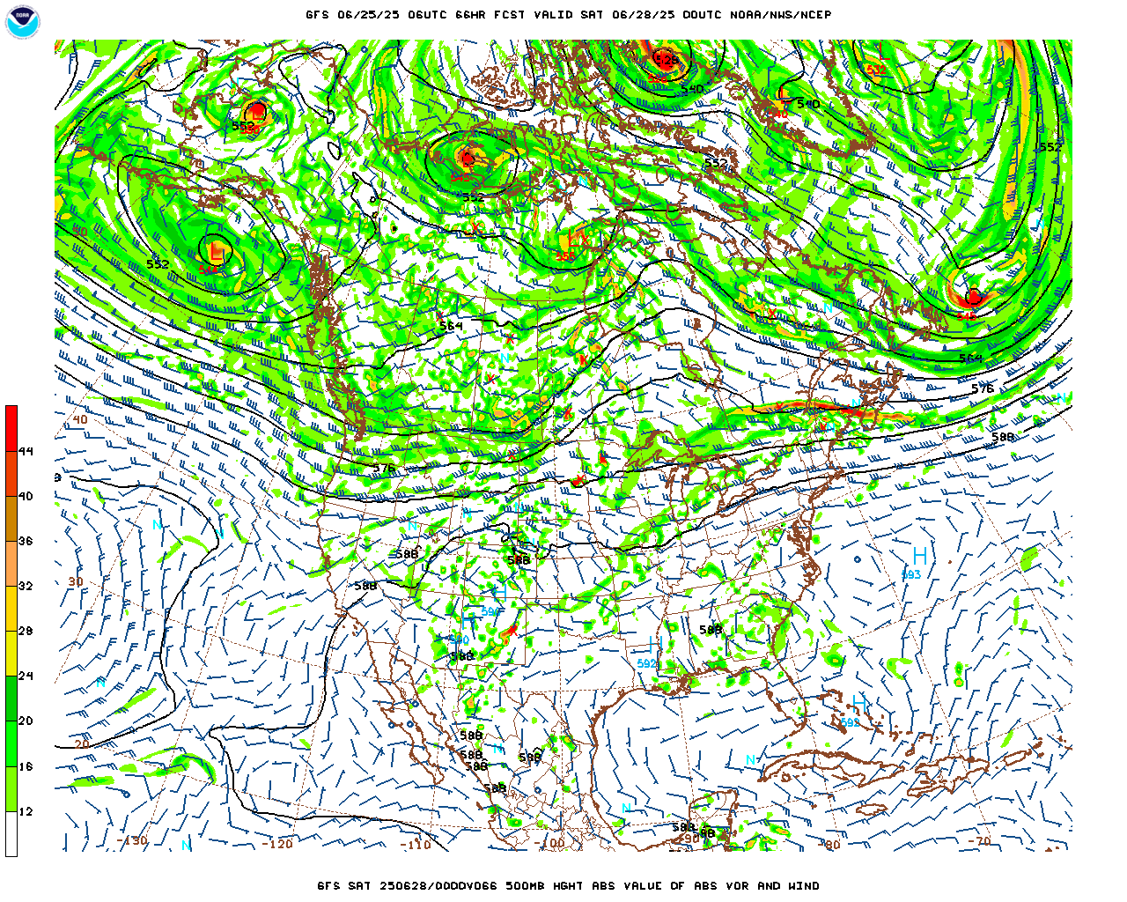
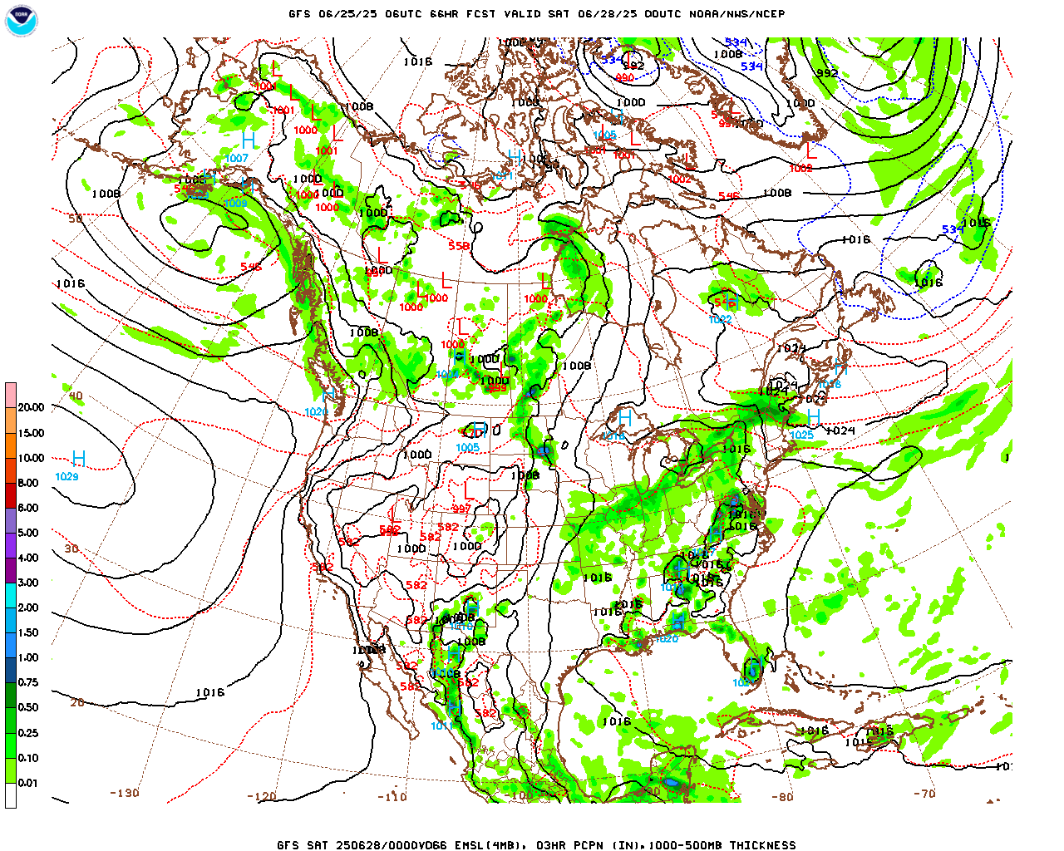
NAM/GFS/NAEFS
http://mag.ncep.noaa.gov/model-guidance-model-area.php
t=66h 2025062800Z Fri June 27 pm
L
L
L
L
L
L
L
L
L
L
L
L
L
H
L
H
H
L
L
H
each 10H x 12.4W
Notes:
Update manually for now – Markus’ tool looping may be too slow to be efficient.
NWP maps from NCEP’s NAM/GFS/NAEFS models. From this main page, choose the Model Area and Model Type. On the next page, choose the initialization time from the top row of the table, then choose the parameters you wish to view, and the forecast time (hours from initialization). Note it is difficult to capture individual images when looping through the output, so instead choose the forecast hour you wish to display. Remember to change the date and time in the text box above the charts!
Copy this slide to a new one if you want to show additional forecast times.
Left: 500 hPa level (5-6 km up)
Right: Surface – green/blue areas show forecast precipitation
Highlight ridges and troughs and areas without significant upper air features. The latter are often prone to fire if unchanged over a period of a few days or more. Indicate areas where lightning/heat/dryness/wind may cause problems, and where significant rain is expected.

Slide 13
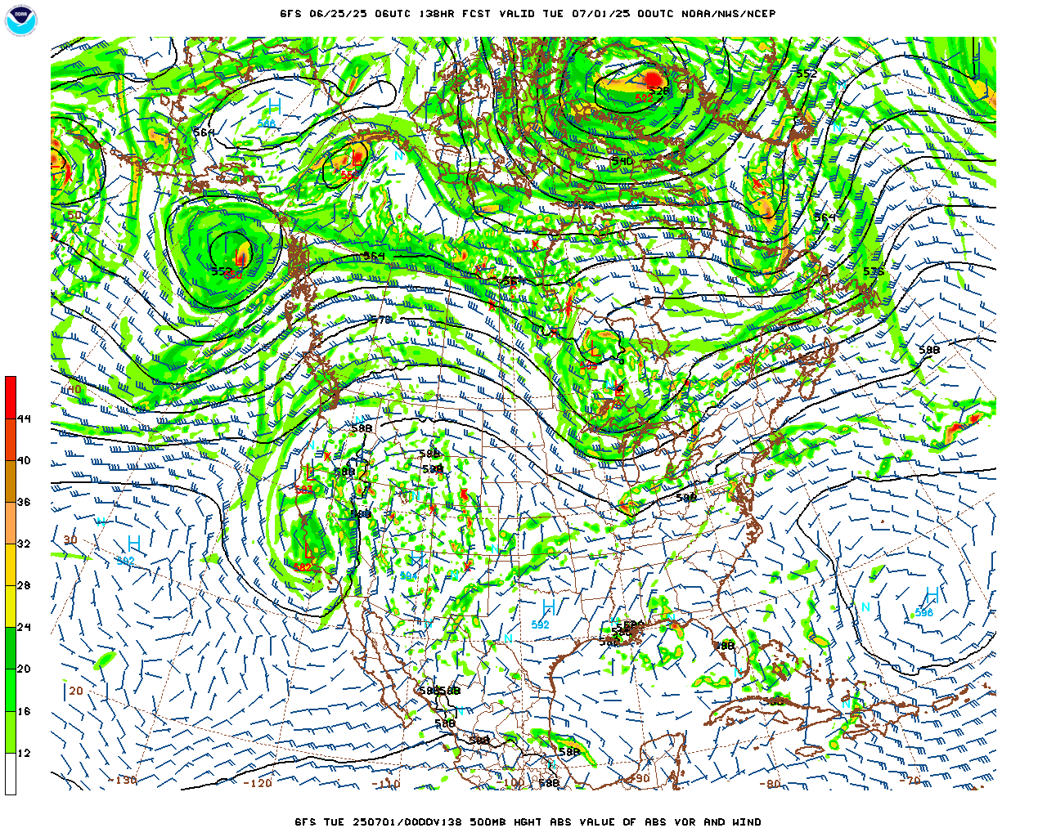
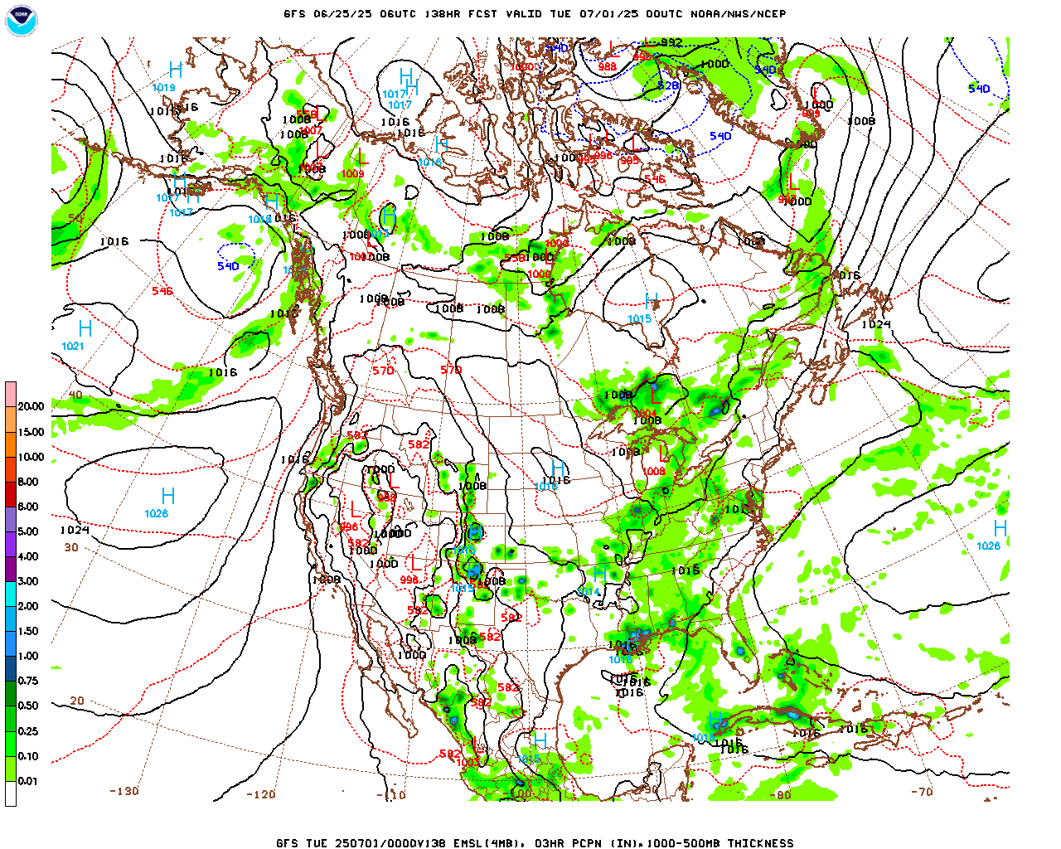
NAM/GFS/NAEFS
http://mag.ncep.noaa.gov/model-guidance-model-area.php
t=138h 2025070100Z Mon June 30 pm
L
H
L
L
L
L
L
L
L
L
L
H
H
H
H
L
L
H
L
H
L
L
H
H
H
each 10H x 12.4W
Notes:
Update manually for now – Markus’ tool looping may be too slow to be efficient.
NWP maps from NCEP’s NAM/GFS/NAEFS models. From this main page, choose the Model Area and Model Type. On the next page, choose the initialization time from the top row of the table, then choose the parameters you wish to view, and the forecast time (hours from initialization). Note it is difficult to capture individual images when looping through the output, so instead choose the forecast hour you wish to display. Remember to change the date and time in the text box above the charts!
Copy this slide to a new one if you want to show additional forecast times.
Left: 500 hPa level (5-6 km up)
Right: Surface – green/blue areas show forecast precipitation
Highlight ridges and troughs and areas without significant upper air features. The latter are often prone to fire if unchanged over a period of a few days or more. Indicate areas where lightning/heat/dryness/wind may cause problems, and where significant rain is expected.

Slide 14
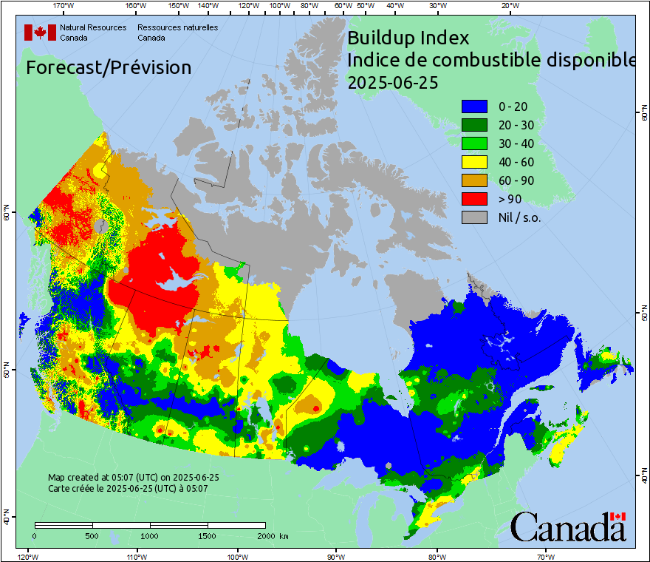
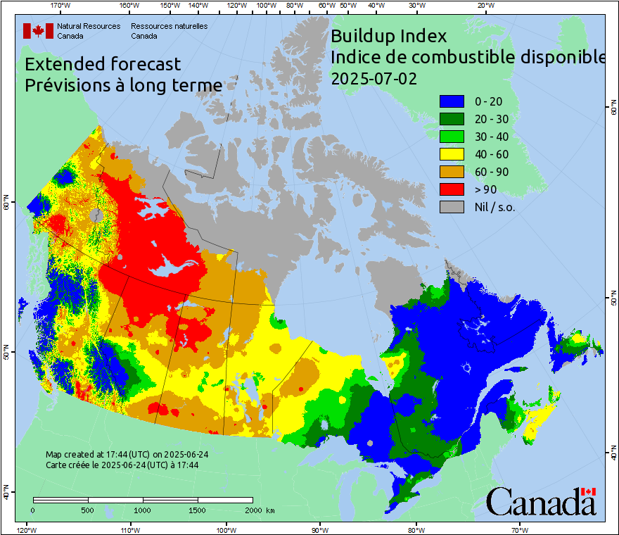
CFFWIS -- BUI
9H x 8W
9H x 10.4W
Notes:
Update images manually – CWFIS images URLs are date-specific.
CWFIS forecast Fire Weather Index or other themes. Choose the most relevant for the forecast period and uptrend or downtrend of indexes. Discuss rapid or ongoing changes between days.
Composite of Canadian, American, and Mexican fire danger updated at 8, 12, 18, 23 MDT
Canadian: Forecast conditions at 0800 and 1200 runs; observed conditions at 1800 and 2300 runs
American: Observed conditions, run by USFS
Mexican: Observed conditions, run by CFS-WFIS
Watch map text for source of data

Slide 15
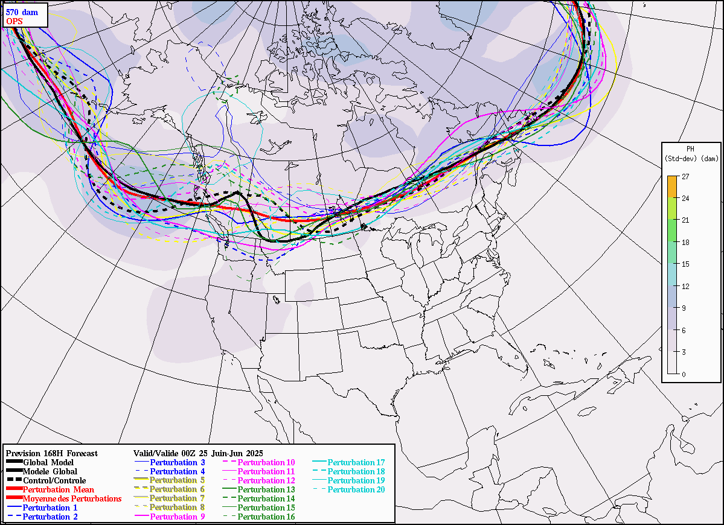
Ensemble 7d (t=168h Tue pm)
http://weather.gc.ca/ensemble/index_e.html#spagat
Local repository: W:\EDM\Fire\CIFFC\WeatherBriefings\Gen_Image_Repo\cef5702.png
L
H
H
L
570 dam
H
H
H
14.5H x 20W
Notes:
Updates automatically if downloaded using Markus’ tool. You may have to change the local link between cef5581.png and cef5701.png, depending on the month.
Spaghetti plot of some geopotential height. The 558 dam line is likely good for spring and fall, and the 570 for summer.
Choose the contour line, forecast initialization date and time, and the number of hours into the forecast you wish to feature from the drop-down boxes under “Spaghetti Plots” at the top of this URL-linked web page. You can scroll back and forth between forecast hours within the display. If you choose a different time, be sure to change the hours and valid day in this slide’s title.
Tangled lines indicate uncertainty between ensemble elements, and uncertainty in forecast conditions.
Tightly-bound lines indicate a high degree of certainty of contour line placement and forecast conditions.

Slide 16
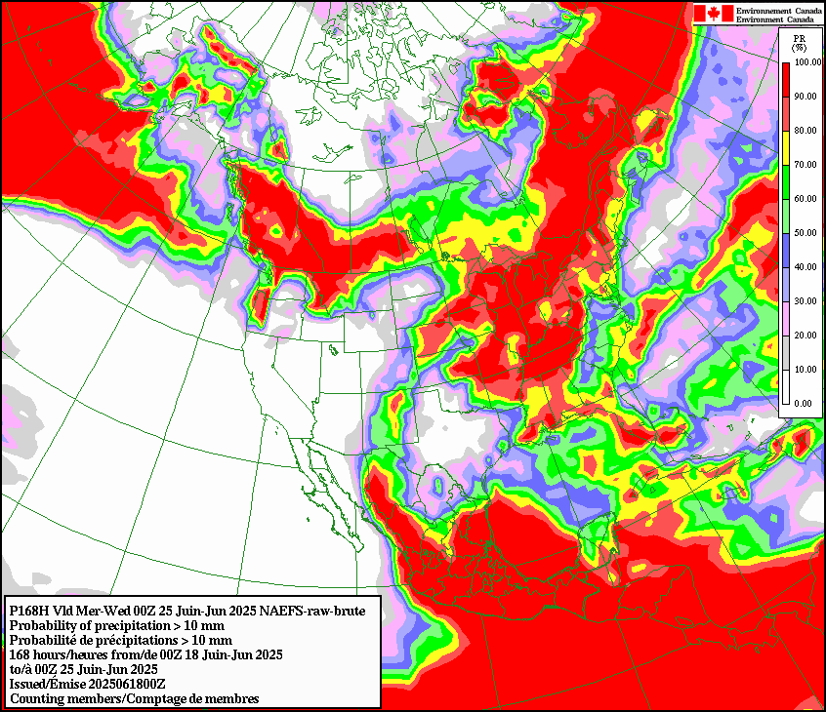
NAEFS
http://weather.gc.ca/ensemble/index_e.html#spagat
Local repository: W:\EDM\Fire\CIFFC\WeatherBriefings\Gen_Image_Repo\naefstotalPcp168h1.png
June 25 – July 2 00z
10 mm accumulation
14.5H x 16.8W Inset 250%
Notes:
Updates automatically from local repository if downloaded using Markus’ tool. If you want a different precipitation threshold or time period then update manually from the web.
Choose the “Precip. accumulation” amount you want to show from the “Product Type” drop-down box. Choose the model initialization time (00 or 12) from the drop-down on the right, then run out the “Forecast End” date for the period you need.

Slide 17
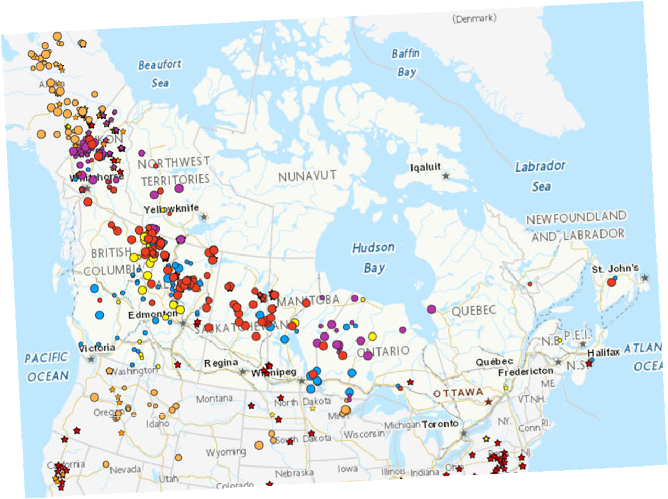
Graphic Summary – Week 1
June 25 – July 2, 2025
Warm, scattered showers/thundershowers
Mostly warm / dry
Warming, drying June 29 on
Showers/
Thundershowers
Periodic showers/Thundershowers
15.5H x 20.0W
Notes:
Summarize the expected fire weather conditions in the regions of the country indicated.
Use red font for regions of intense activity
Use orange font for regions of moderate activity
Use yellow font for regions of low activity
Use green font for regions of minimal activity
Add specific comments for each region. These may be included in items such as CIFFC SPU call minutes, so be clear and concise as possible
Summarize the expected fire weather conditions in the regions of the country indicated.
Use red font for regions of intense activity or expected high fire weather indexes.
Use blue font for regions expecting substantial rainfall or with low fire weather indexes.
Use shapes to outline regions, and symbols to indicate lightning or other relevant conditions.

Slide 18
Fire weather indexes trends
Summary of national fire weather expectations June 25 – July 2, 2025:
Little or no activity A few small fires
Large fires possible Widespread intense activity
Several weather systems impact the country this week. They move quickly and will bring significant moisture. The north continues to be dry. Seasonal to cool temperatures in the west.
West (BC/YT/NT/AB):
BC: Steady, rising Sunday June 29 onward
YT: Steady
NT: Steady
AB: Steady, rising Sunday June 29 onward
  Central (SK/MB/NU/ON):
  SK: Steady then rising after June 28-29 weekend
  MB: Rising then falling June 28-29 weekend
  ON: Rising then steady on weekend of June 28-29 and after
East (QC/Atl);
QC: Mainly dry
Atl: Mainly dry
mH x nW
Notes:
Summarize the expected fire weather conditions in the regions of the country indicated.
Use red font for regions of intense activity
Use orange font for regions of moderate activity
Use yellow font for regions of low activity
Use green font for regions of minimal activity
Add specific comments for each region. These may be included in items such as CIFFC SPU call minutes, so be clear and concise as possible

Slide 19
Weather Notes: June 4 – June 10, 2025
Updates:
1
Fire Weather This Week [06-03 Buchart]
Updated Mon, Weds, Fri
A low sits over southern Nunavut and is giving precipitation to the far north of the prairies and southeastern NWT. This system will weaken over the coming 36 hours. The low-pressure system is bringing a cooler airmass (though relatively dry) to AB, SK, and MB. Westerly winds of ~30km/h will impact over SK and MB through June 4.
A series of weak troughs will bring patchy, yet consistent precipitation to AB and northwest SK June 3-4 that will begin to lower fire weather indices.
Another low-pressure system developing June 4 will drag precipitation through much of eastern ON and QC, then Atlantic Canada by June 6. This will keep fire weather indices relatively low.
A third system is forecast to develop over the southern NWT on June 5. The associated cold front is likely to bring thunderstorms and lightning to northern BC Thursday evening. More intense thunderstorms can be expected to the south of the low as it moves southeast, though rain should minimize lightning ignition potential. As it tracks southeast, the system will strengthen, bringing up to 10-20mm of rain in a band from northern SK into much of MB by Sunday June 8.
Southern BC remains dry and warm with no rain expected in the next week. Fire Indices continue to increase in this region, giving extreme risk.
mH x nW

Slide 20
Questions or suggestions?
Contact:
Richard Carr or Liam Buchart
Wildland Fire Research Analyst
Richard.Carr@NRCan-RNCan.gc.ca
Liam.Buchart@NRCan-RNCan.gc.ca
5320 122 Street NW
Edmonton, AB, Canada
T6H 3S5
Richard: 825-510-1265
Liam: 825-510-1211
?
?
?
?
?

