Slide 1
NRCan Fire Weather Products
Richard Carr
Natural Resources Canada -- Canadian Forest Service

Slide 2
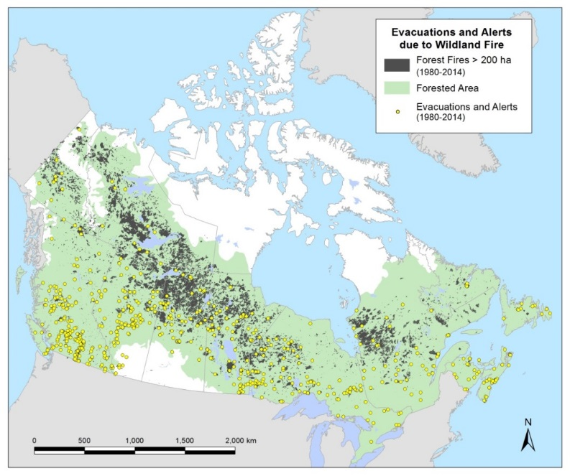
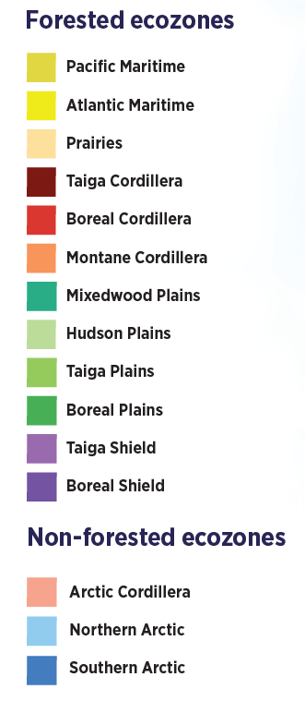
Canada’s Forests
Total area of about 3.62 million km²
40% of Canada’s land area
~33% of Canada is boreal forest
Most fire activity occurs
in the boreal forest
The State of Canada’s Forests (2021)

Slide 3
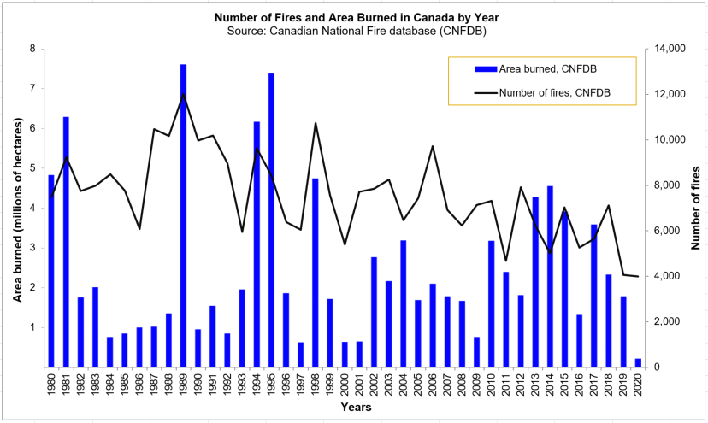
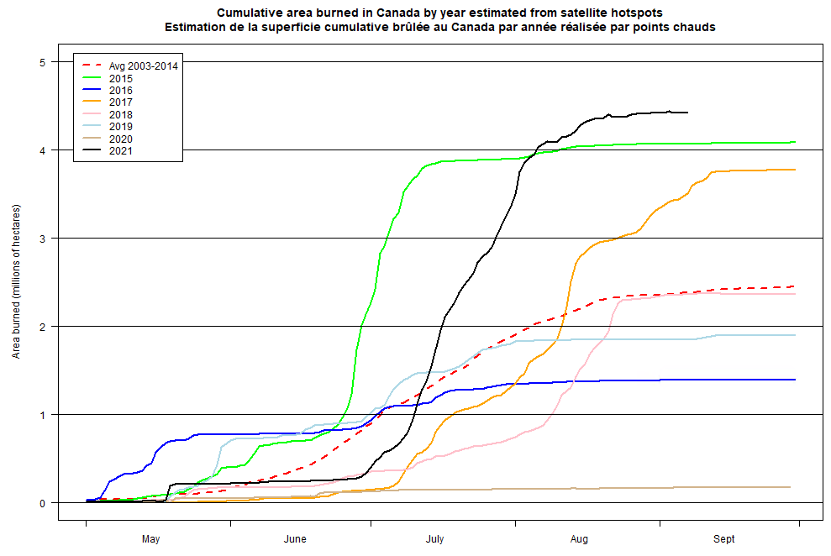
Fire Occurrence in Canada
Each year has about:
7,500 forest fires (NFDB 1990-2016)
2.5 million ha burned (NFDB 1990-2016)
26 communities (9000 people) evacuated
Great annual variability
Past 7 years activity

Slide 4
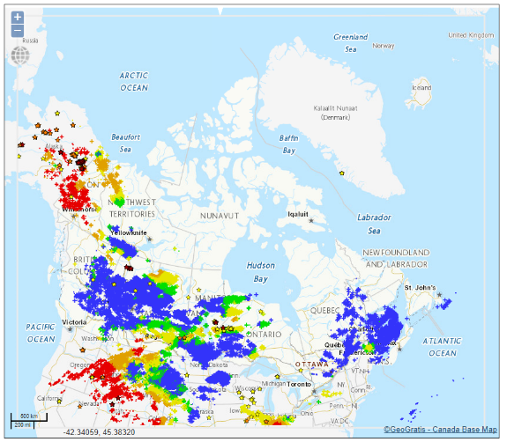
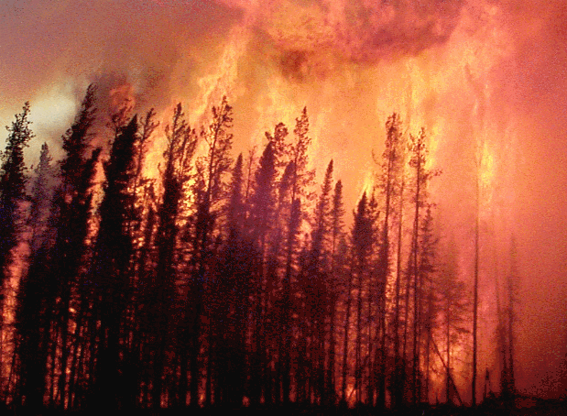
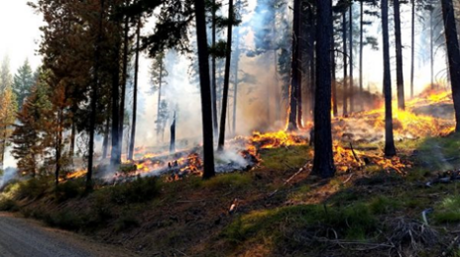
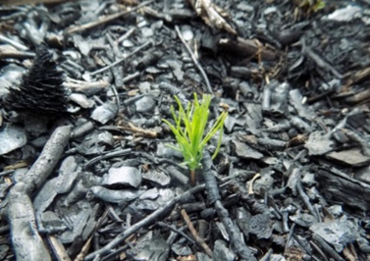
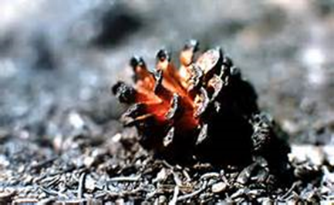
Fire Starters
Natural phenomena
Lightning
Other causes: rare
Humans
Recreational
Industry
Lax diligence
Natural landscape renewal:
Opens serotinous cones
Restarts natural growth cycles
Cleans flammable surface fuels
Notes:
Serotinous=“closed” – seed dispersion is gradual or occurs later

Slide 5
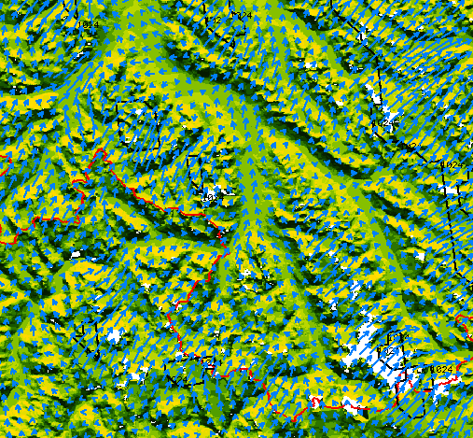
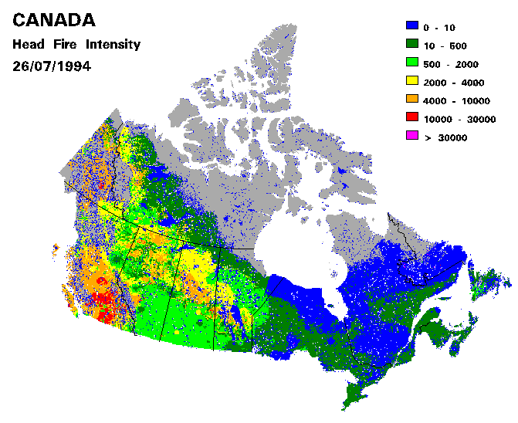
My first years at NoFC
Regional Atmospheric Modeling System
Summer Position – 1994
Casuals/terms follow
(thanks, Kerry Anderson
and Bryan Lee!)
CWFIS development
1994: Bryan Lee, Rod Suddaby,
Phil Blower
1995: Public access to web site

Slide 6

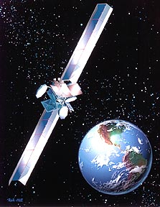
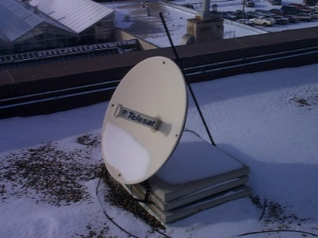
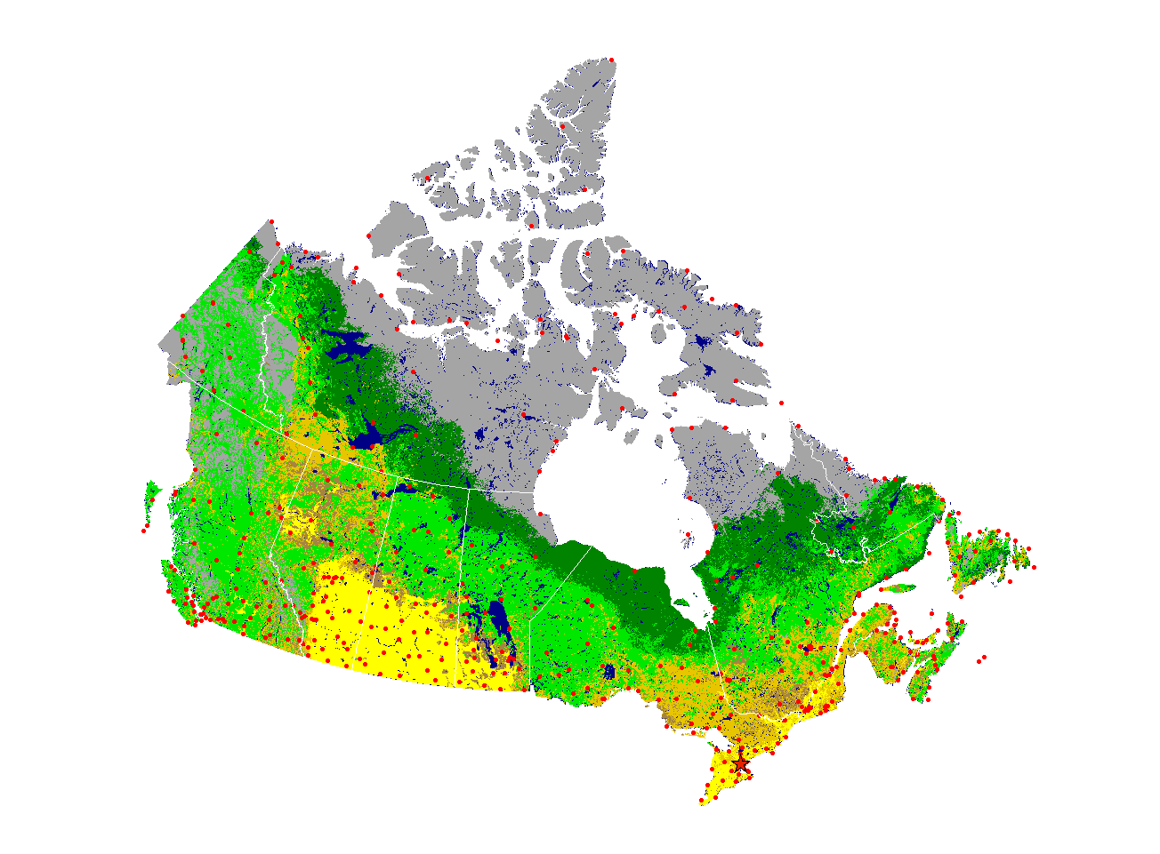
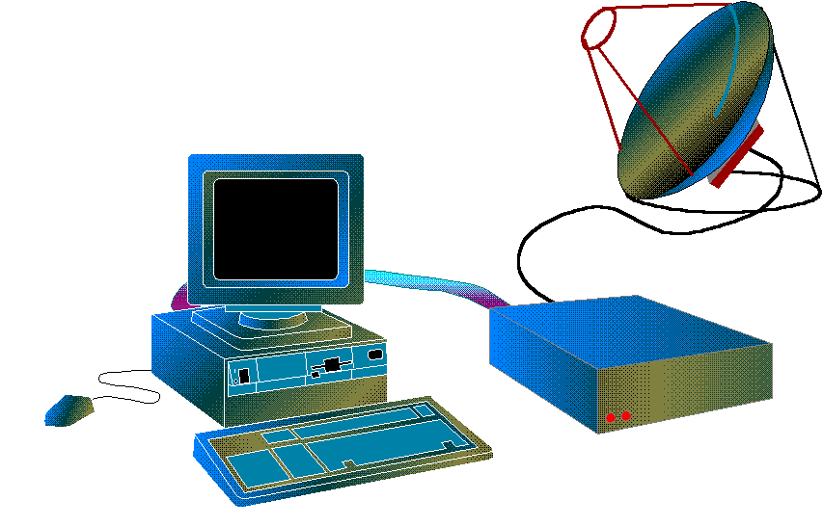


1996: CWFIS operations yank me in!
SACN02 CWAO 010300
WLV SA 0300 AUTO8 M M M 110/23/18/1401/M/ PK WND 1622 0242Z 3001 02MM=
WJL SA 0300 AUTO8 M M M 086/20/10/2301/M/ 3002 56MM=
WMM SA 0300 AUTO8 M M M 124/25/14/2103/M/ 5008 94MM=
WLF SA 0300 AUTO8 M M M 148/17/15/2402/M/ 0013 72MM=
WJV SA 0300 AUTO8 M M M 073/26/14/1103/M/ 6018 46MM=
https://www.clipartkey.com/
SACN31 CWAO 021200
METAR CYAW 021200Z 28023G35KT 15SM SCT035 SCT090 BKN250 M08/M14 A2920 RMK SC3AC1CI2
DA-1806FT SLP892=
METAR CYBG 021200Z 29020G31KT 6SM -SN BLSN SCT015 OVC025 M23/M27 A2970 RMK SC3SC5 SLP075=
METAR CYQQ 021200Z 28002KT 20SM BKN065 BKN140 02/01 A3006 RMK SC6AC1 SLP180=
METAR CYTR 021200Z 29008KT 15SM FEW025 M16/M24 A3032 RMK SC1 SLP275=
METAR CYYR 021200Z 03020G29KT 3/4SM -SN DRSN VV006 M04/M04 A2915 RMK SN8 /S06/ SLP876=

Slide 7
Weather formats decoded
SA -- hourly (deprecated)
METAR – hourly (international)
SW-OB – hourly ECCC specialized XML
Now used instead of METAR for Canadian reports
SX, CS – every 6 hours (not used now)
Synoptic – every 6 hours
Solar radiation, wave heights, snow characteristics, …
Radiosonde (weather balloon) – every 12 hours
Provincial/territorial (text, csv, JSON, XML)
GRiB, NetCDF?
Notes:
7

Slide 8
Surface Parameters saved
Dry bulb, dew point temperatures
Daily maximum, minimum, mean temperatures
Relative humidity (calculated)
Pressure
Wind speed, gust speed, direction
Precipitation in past report periods (1, 6-24 hrs)
Rain, snow (cm), snow water, snow depth (cm)
Cloud fractional coverage and ceiling
Horizontal visibility
Synoptic state of weather (Hourly obs: derived)
Lightning activity estimate (derived)
Decoders can output other parameters
Notes:
8

Slide 9
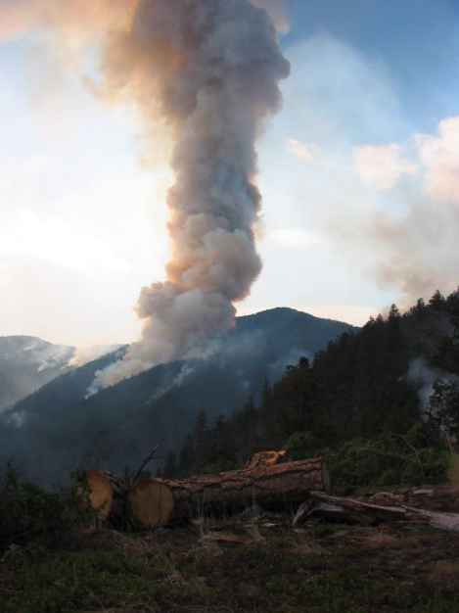
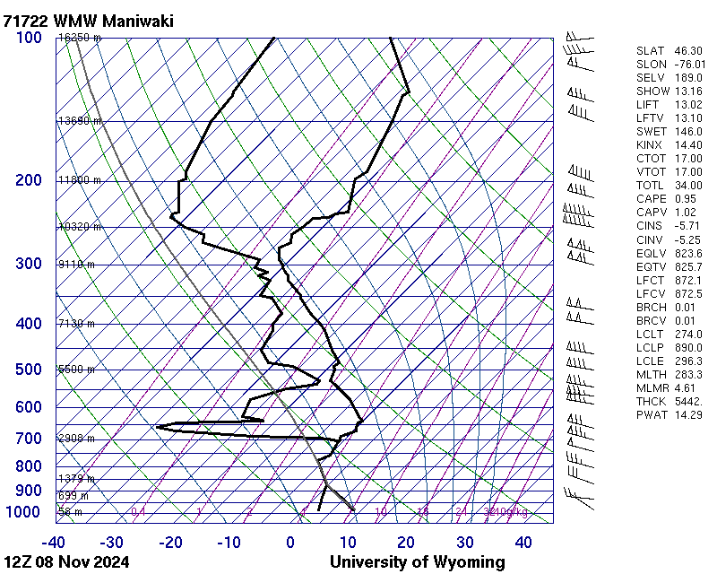
Upper Air Parameters
Temperature, Dew Point temperature
Pressure, height
Relative humidity (calculated)
Wind speed, direction
Stability indexes (calculated)
Totals
Showalter
K
SWEAT (Severe WEAther Threat)
Lifted Index
CAPE (Convective Available Potential Energy)
Haines and Continuous Haines
Use: Atmospheric Dispersion Index, Ventilation Index, …
Notes:
9

Slide 10
Canadian Forest Fire Danger
Rating System (CFFDRS)

Slide 11
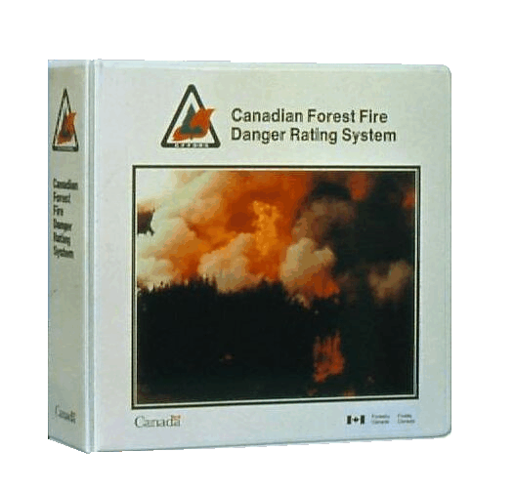
Canadian Forest Fire Danger Rating System
The Canadian Forest Service developed the CFFDRS to predict fire danger in Canada.
It has been important in Canadian forest protection operations since 1970.
Risk
(lightning and
people-caused)
Weather
Topography
Fuels
FOP
System
FWI
System
FBP
System
Accessory
Fuel Moisture
System
CFFDRS

Slide 12
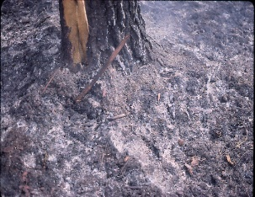
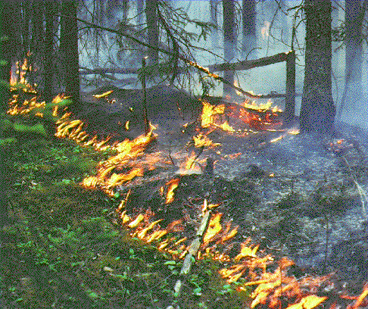
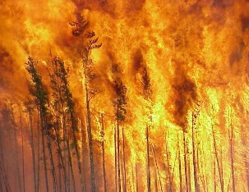
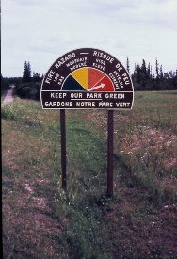
Canadian FWI System Indexes
Noon local standard time; hourly calculations can be done
Fire Weather
Observations
Temperature
Humidity,
Wind, Rain
Temperature,
Humidity,
Rain
Snow depth
Barometric Pressure
Horizontal Visibility
Cloud cover and type
Upper air data
Wind
Temperature,
Rain
Fuel Moisture
Codes
FFMC
Fine Fuel Moisture Code
DMC
Duff Moisture Code
DC
Drought Code
Fire Behavior
Indexes
ISI
Initial Spread Index
BUI
Buildup Index
FWI
Fire Weather Index
BUI
fuel consumption
ISI
rate of spread
DSR/MSR/SSR
FWI
fire intensity

Slide 13
Canadian Forest Fire Behaviour
Prediction (FBP) System
Inputs
FBP System
Fuel Type
FFMC, ISI, BUI
Wind Speed
Wind Direction
Percent Slope
Upslope Direction
Elevation
Lat / Long
Date
Elapsed Time
Point or Line
Ignition
Fuels
Weather
Topography
Foliar
Moisture
Content
Type / Duration
of Prediction
Canadian Forest Fire
Behavior Prediction
(FBP) system
Outputs
Primary
Secondary
Rate of Spread
Fuel Consumption
Head Fire Intensity
Fire Description
- Fire Type
- Crown Fraction Burned
Head, Flank & Back Spread Distances
Flank & Back Fire Rates of Spread
Flank & Back Fire Intensities
Elliptical Fire Area & Perimeter
Rate of Perimeter Growth
Length-to-Breadth Ratio

Slide 14
“Next Generation” CFFDRS
Reconciliation of discrepancy between hourly and daily calculations
Grass fire (and peat module) to come – adds a couple more boxes the CFFDRS schematics
Physical fuel description options for FBP

Slide 15
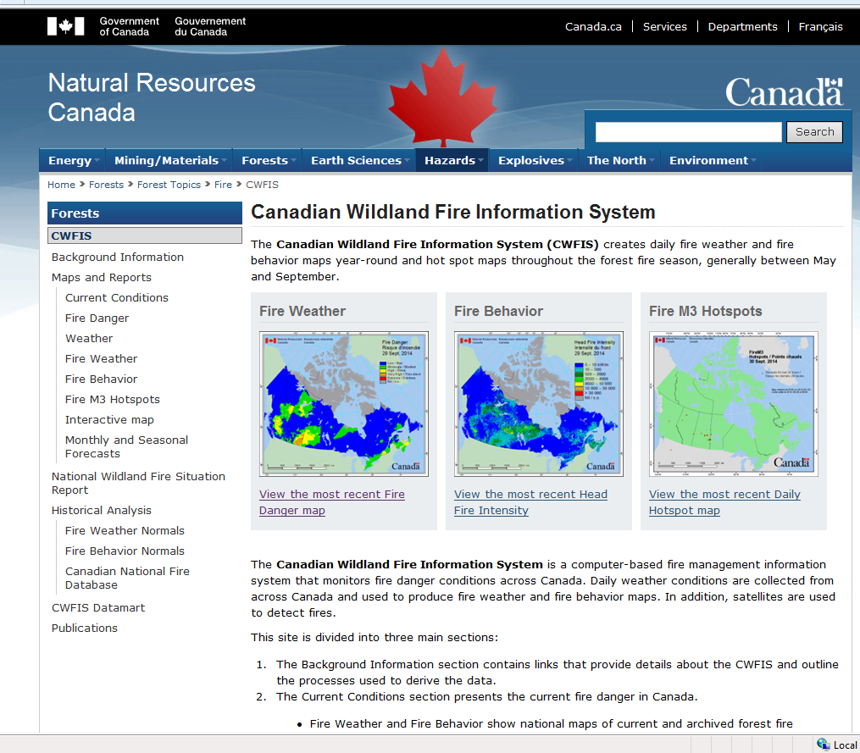
CWFIS: Web site front page (bilingual)
The CWFIS provides national fire weather, fire behaviour, fire locations, and other information.
http://cwfis.cfs.nrcan.gc.ca
Provincial/territorial web sites provide operational focus in their jurisdictions.
Revised web site will be released late spring 2025?

Slide 16
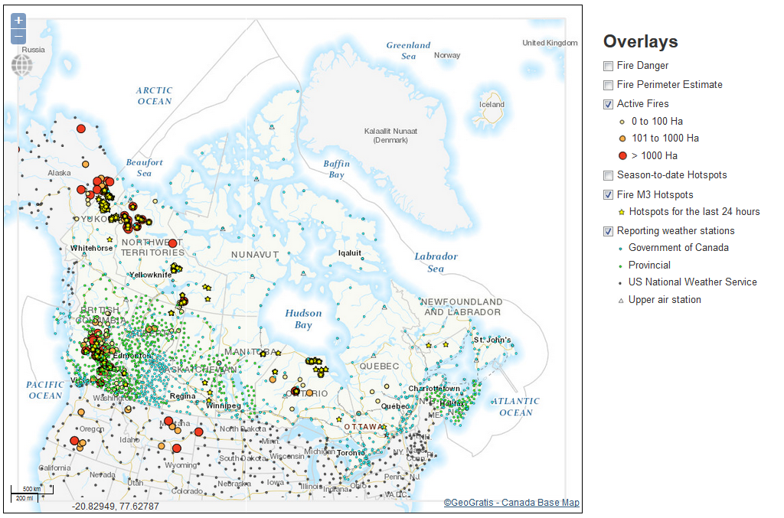
CWFIS: Interactive map and other features
Background information
Clickable layers to display underlying information
Interactive map
Base maps
Fire locations
Hotspots
Perimeter estimates
Fire Danger (all FWI themes soon)
Fire History (1980 to current)
Many layer available using WFS, WCS, WMS
Internal site includes fire growth modeling, smoke forecast, extra base layers, …

Slide 17
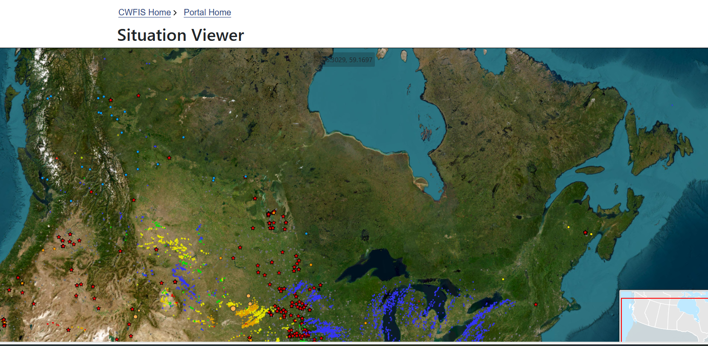
CWFIS: Internal viewer
Many features available

Slide 18
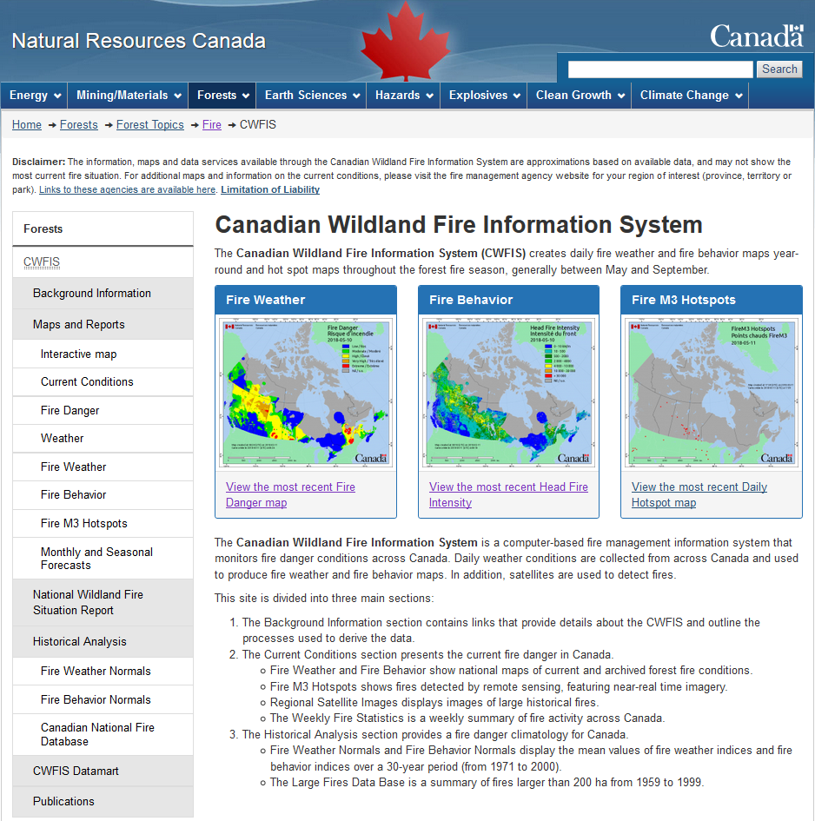
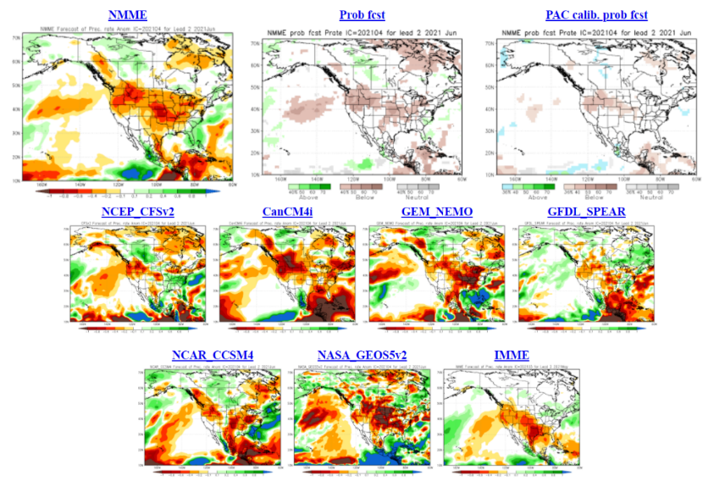
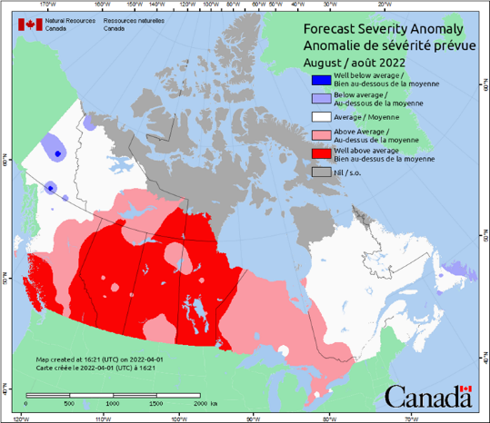
Seasonal Forecasting
CanSIPS + NRCan FWI outputs
New procedure in development phase

Slide 19
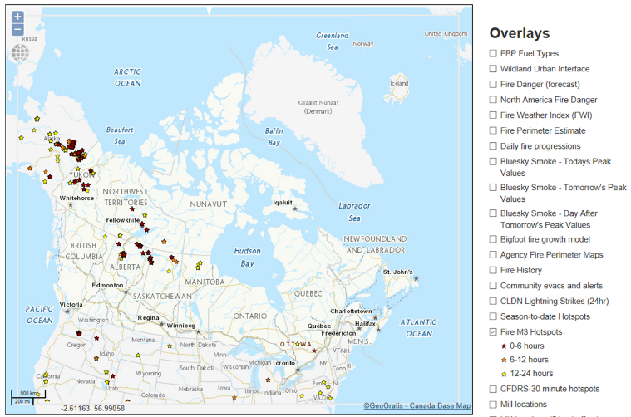
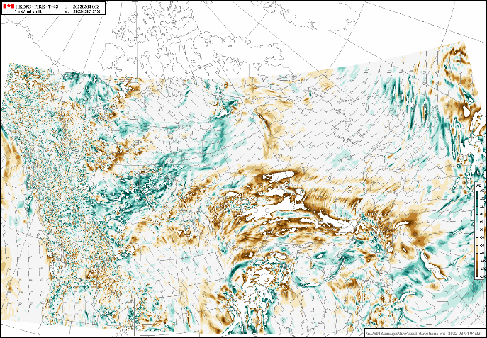
Outreach & Interaction with Other Projects
CIFFC: Meteorology Working Group, Fire courses, …
NADM, NASFAO
Fire weather briefings
CIFFC/GOC, Seasonal forecasts
With ECCC:
Fire weather product and science development
Smoke modeling & health – Firework, working groups, etc
Forecast improvement
Short, medium, long range
This brings us to where we are today!

Slide 20
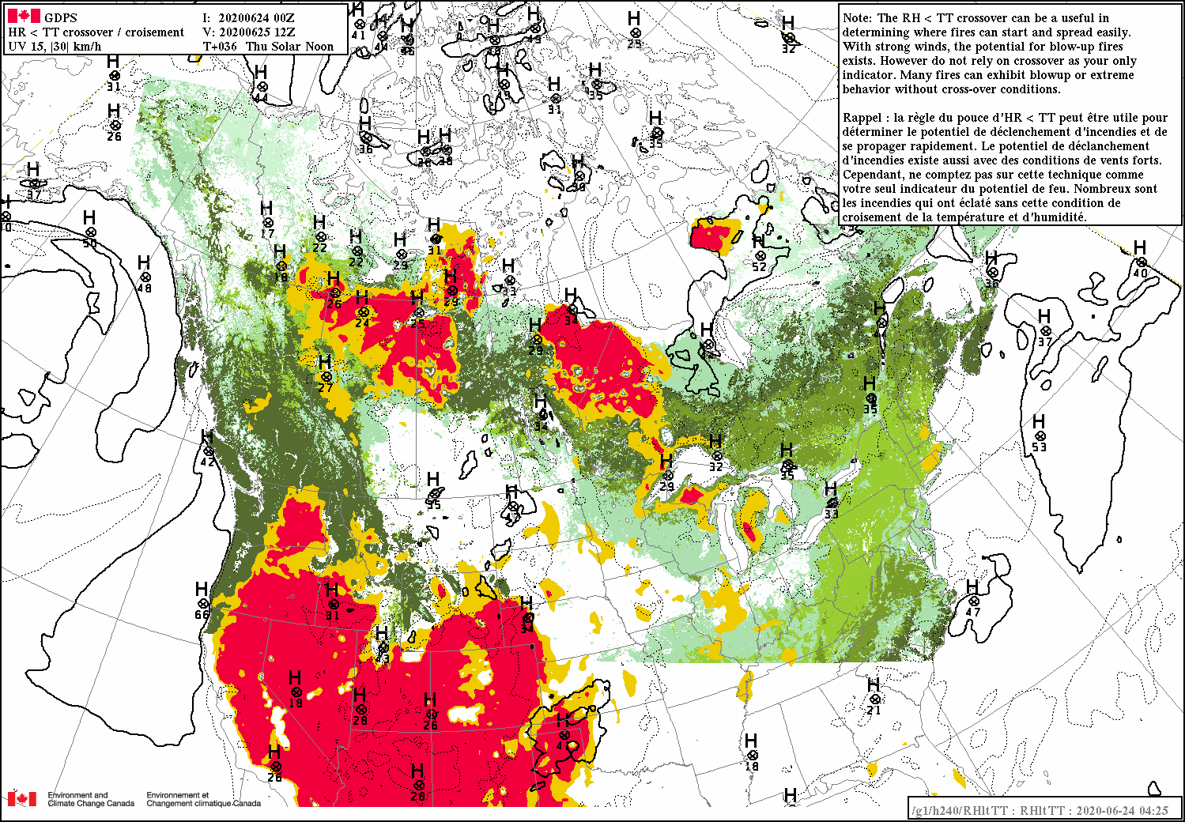
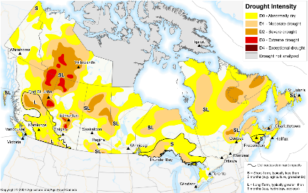
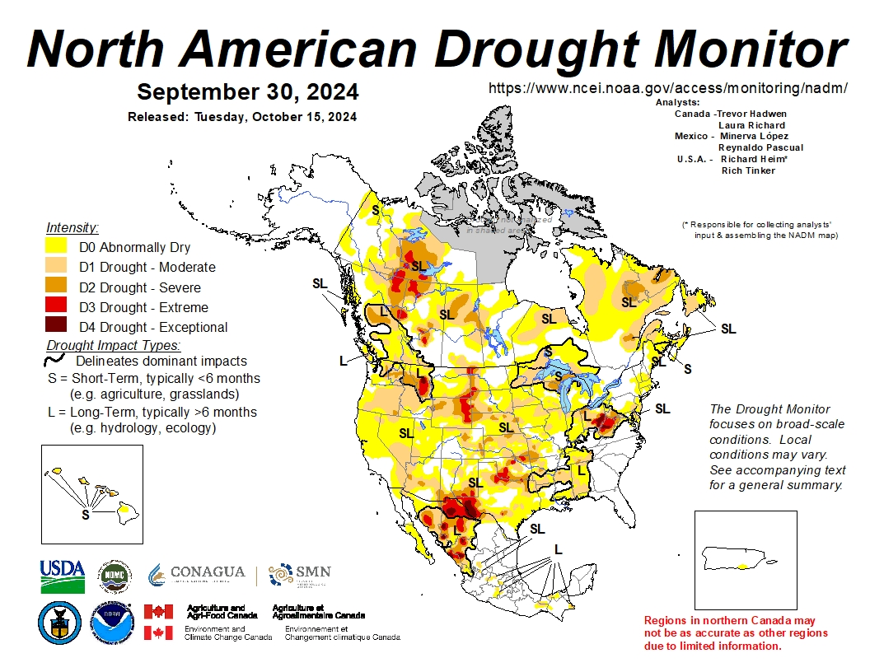
Outreach & Project Interaction
Monthly discussions with ECCC:
Fire weather product and science development
Smoke modeling & health – Firework, AQ, …
CCCS future projections
Forecast improvement – all timescales
Drought monitoring
AAFC, NDMC, NCEI
CIFFC / Meteorology Working Group
Course review and material (e.g. S589)

Slide 21
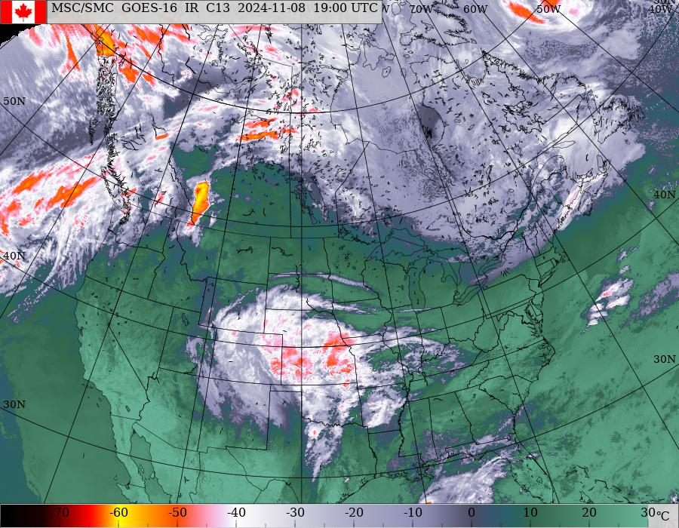
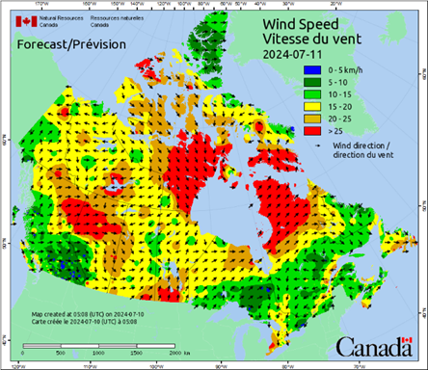
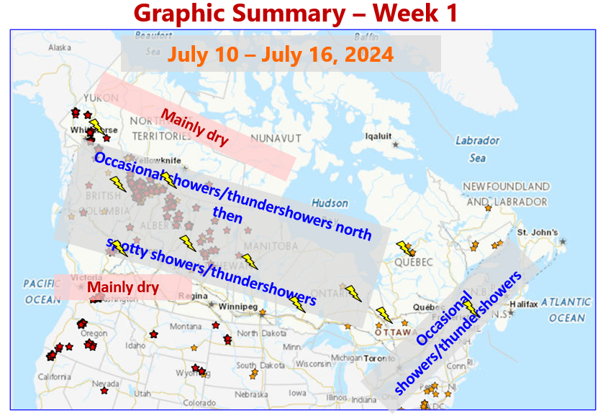
Weekly Duty Officer Weather Briefings
Organized by the Canadian Interagency Forest Fire Centre (CIFFC) ~2013 inception …
Wednesday 10:00 MDT
Precedes the Duty Officer calls
April / early May to September
Outlook for next 7 days
NRCan people welcome
Audience from ECCC, PSC, OGD
Occasional international outlooks
SPU: Focused audience 2-4 week outlooks
Notes:
21

Slide 22
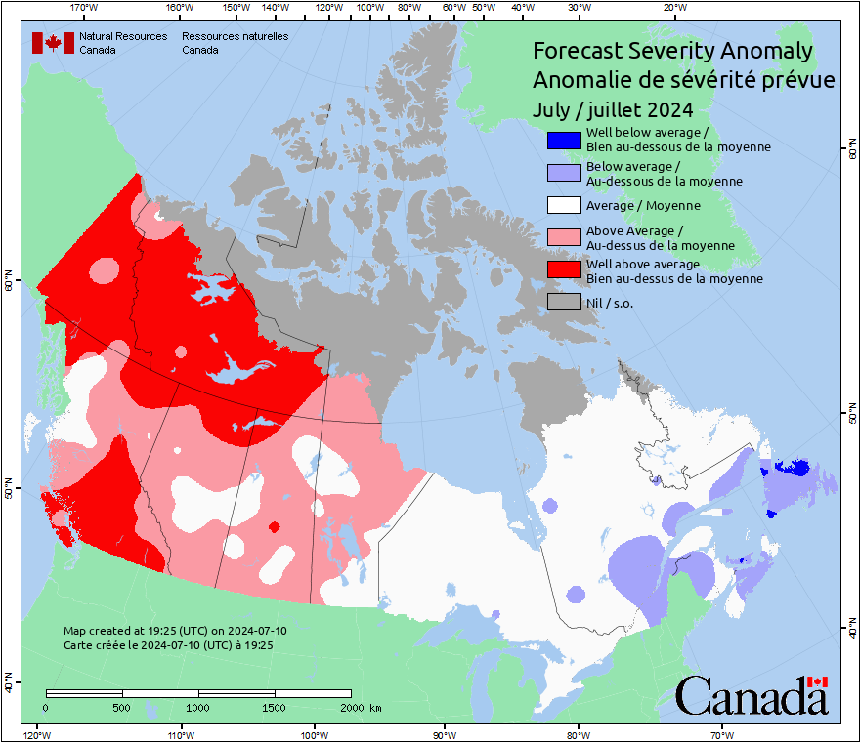
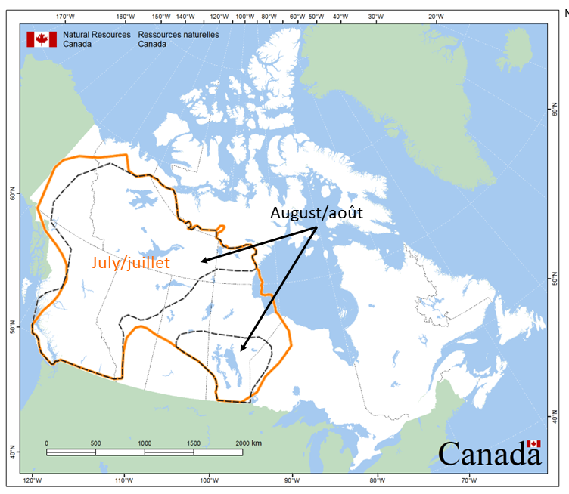
Fire Season Preparations/Reviews
Roles and responsibilities review
Seasonal forecast presentations, Briefing Notes (BNs)
GOC Placemat
Tabletop exercises
Media preparation
After Action Reviews (AARs): autumn

Slide 23
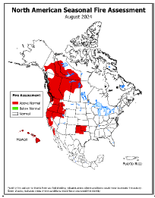
Outreach & Project Interaction
Smoke/AQ/Health:
Interagency Coordination on Wildfire Smoke & Health Res.
Air Health webinar series (Health Canada and others)
North American Seasonal Fire Assessment & Outlook (NASFAO)
Assembled in NICC (Boise, Idaho)
Web page: North American Significant
Wildland Fire Potential Outlook
Monthly USFS climatologist outlooks
Media, museum displays, etc

Slide 24
Questions?
Contact:
Richard Carr
Fire Research Analyst
Natural Resources Canada – Canadian Forest Service
Richard.Carr@canada.ca
5320 122 Street NW
Edmonton, AB, Canada
T6H 3S5
825-510-1265 780-710-3147
?
?
?
?
?
Notes:
24

