Slide 1
Fire Season Severity Anomaly Forecast
for the EUSN
June 17, 2025
Richard Carr Natural Resources Canada – Canadian Forest Service

Slide 2
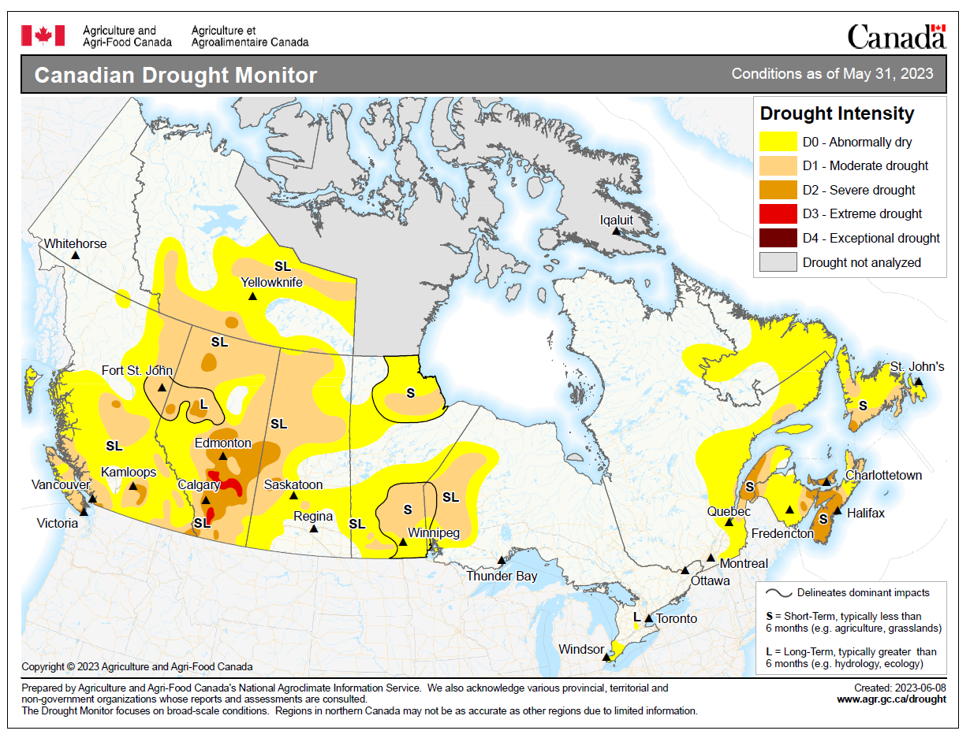
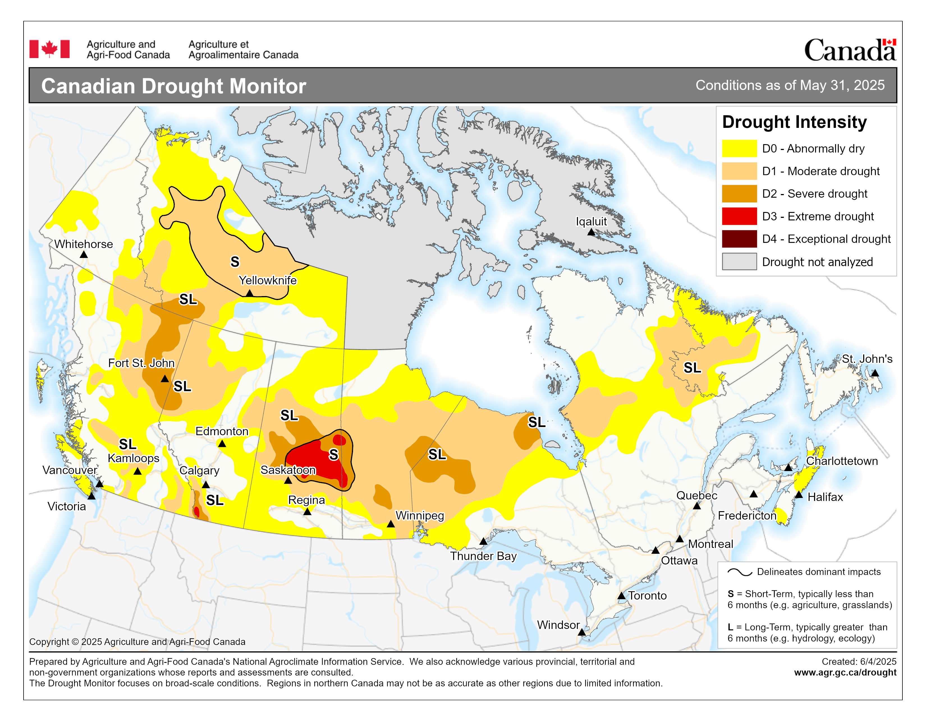
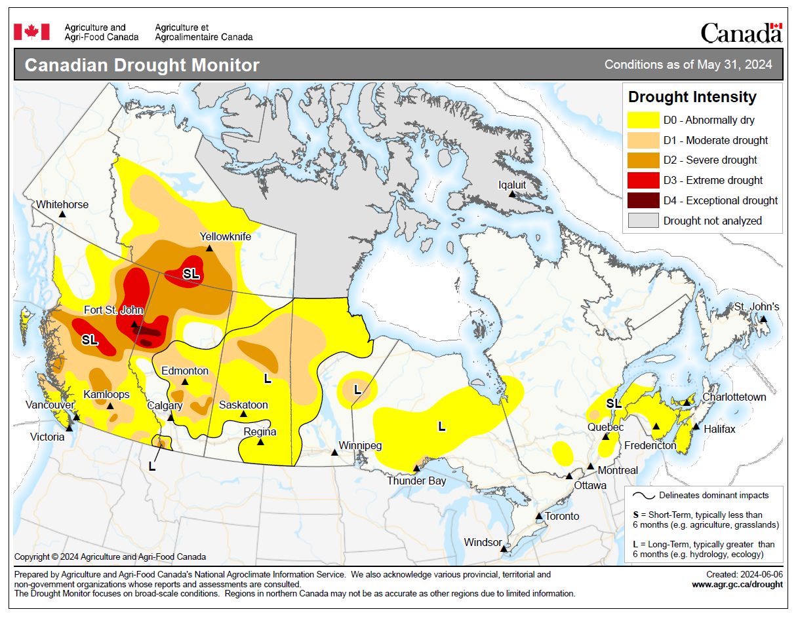
Drought Progression: May 31, 2023-25
Drought was less intense than in spring 2023 and 2024
Intensification during 2023; reduction in mid to late 2024
Notes:
Drought reporting is done by Agriculture and Agri-Food Canada.
2

Slide 3
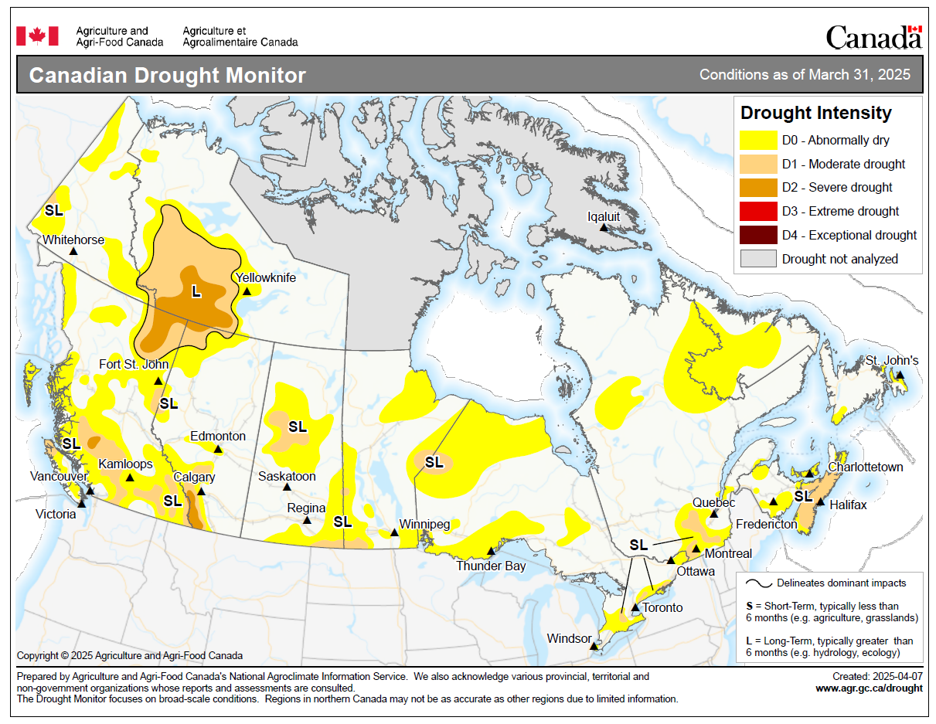
Drought Progression: Spring 2025
Not too dramatic at March 31, April 30
Rapid intensification during May
Some reduction in southwestern NT, southern BC
Notes:
3

Slide 4
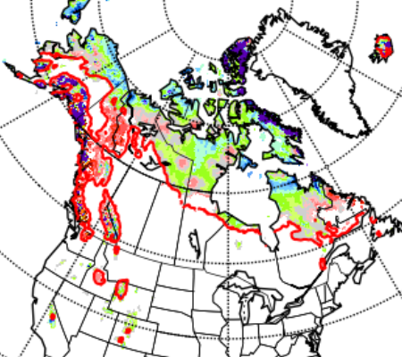
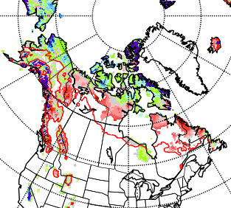
Snow Cover
Snow melted quickly in southern BC in February-March
Snow loss in other regions was normal during spring
May 10, 2023
May 8, 2024
May 14, 2025
Notes:
Snow cover maps are from the Canadian Cryospheric Information Network (ccin.ca). The red line give the locations of the historical mean 2-cm snow depth for the particular date. Regions showing white north of (above) the red line have early snow loss; regions with color south of (below) the red line have snow lingering later than usual. Sometimes, snowfalls in the spring/autumn may give temporary snow cover where snow is usually gone.
4

Slide 5
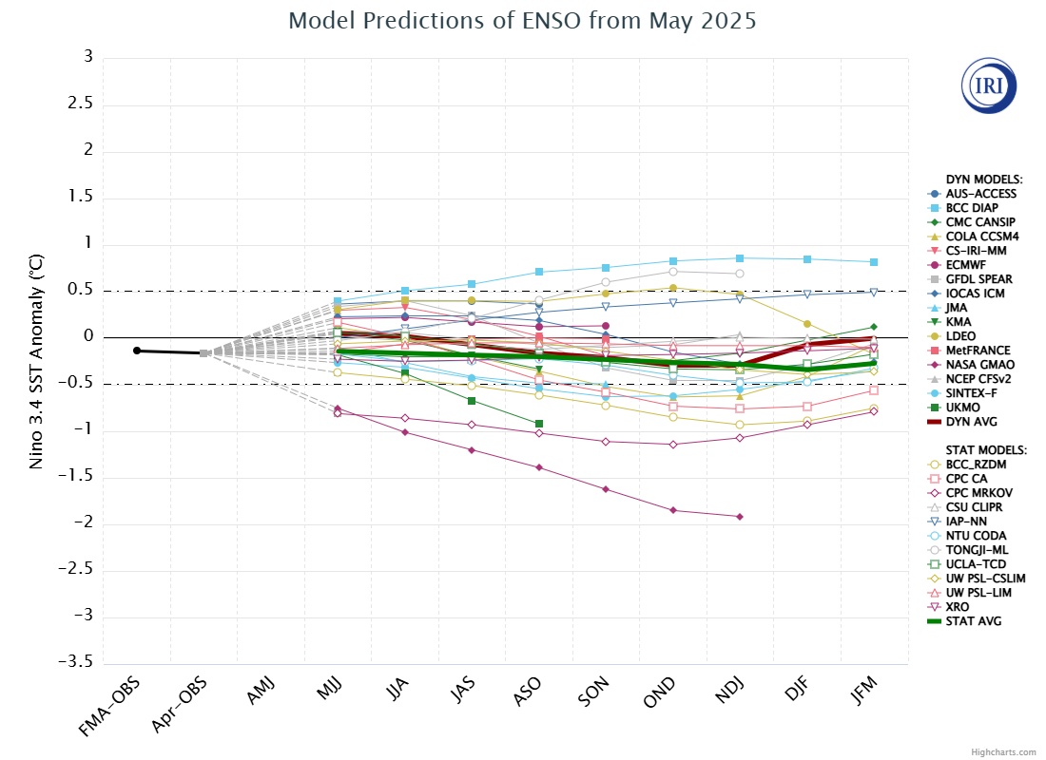
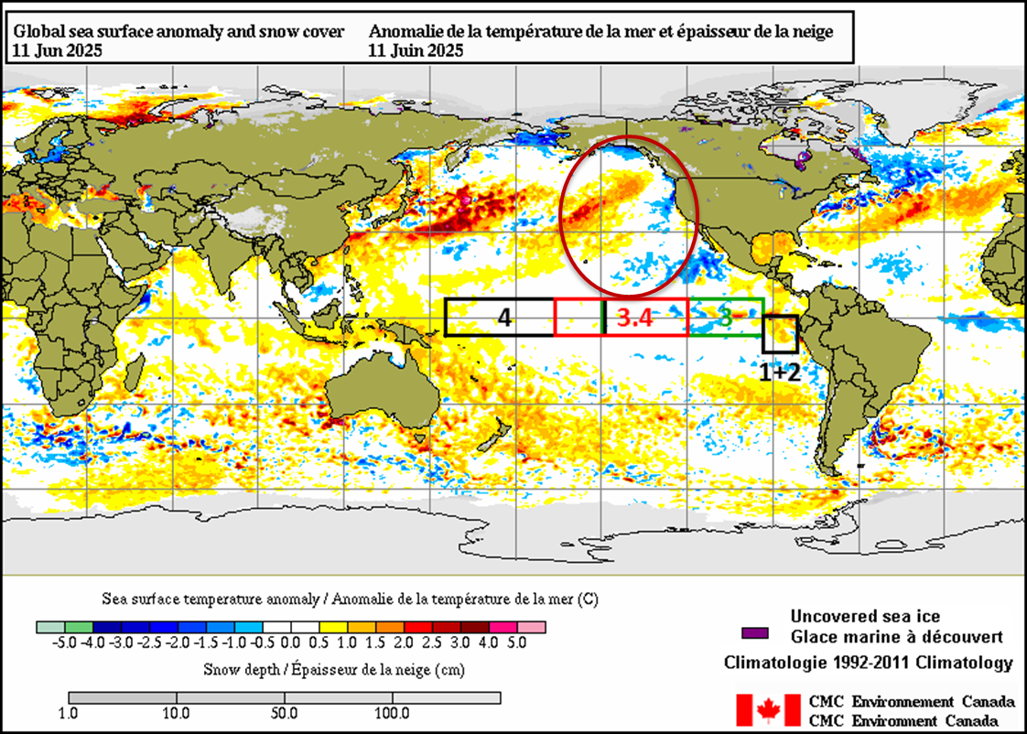
IRI ENSO Forecast
https://iri.columbia.edu/our-expertise/climate/forecasts/enso/current/?enso_tab=enso-sst_table
https://iri.columbia.edu/our-expertise/climate/forecasts/enso/2024-october-quick-look/?enso_tab=enso-sst_image
Neutral conditions likely continuing to winter 2025-26
May, 2025
Notes:
Neutral ENSO is when indexes remain between the horizontal red lines on the plume chart and the black lines on the time series.
El Nino occurs when the indexes are above the top line (+0.5 sea surface temperature anomaly in the 3.4 region) for over 3 consecutive months.
La Nina occurs when the indexes are below the bottom line (-0.5 sea surface temperature anomaly in the 3.4 region) for over 3 consecutive months.
5

Slide 6
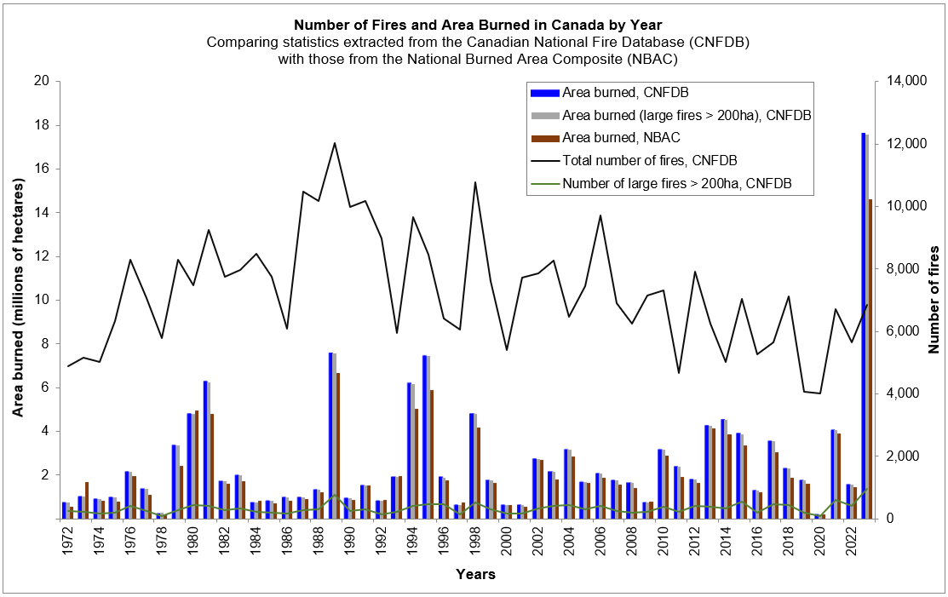
Neutral ENSO: Recent Analog Years
Arrows to area burned: 2012 (orange), 2013—2014, 2017 (black), 2020 (green), 2024 (black)
2024
Notes:
Dominant neutral: greater than 6 months in neutral phase
Other years featured short neutral summer periods (2016, 2018, 2021)
Neutral ENSO may have erratic weather patterns; this may cause some years to have high/low fire activity
6

Slide 7
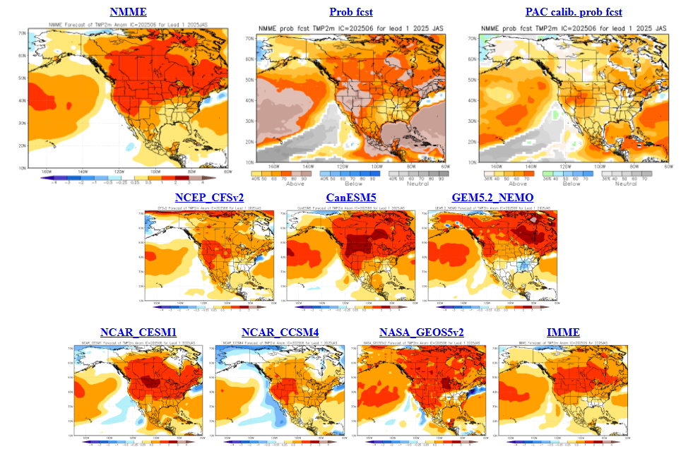
North American Multi-model Ensemble
NMME – June run
JJA Temp
Looks warm …
Subtract a bit of drama to get truer picture!
Notes:
Temperature maps: blue = below normal, orange--red = above normal
Precipitation maps: orange--red = below normal, green = above normal
Seasonal forecasts produced by NRCan use temperature and precipitation from the two 10-member CanSIPS ensembles (green boxes in centre).
GEM-NEMO translates to Global Environmental Multiscale – Nucleus for European Modeling of the Oceans.
Wind data from these models have not been tested yet.
The remainder of the boxes show various models used in the NMME, with combined outputs condensed into the top left box, while
the bottom right box includes European models – the International Multi-Model Ensemble (IMME).

Slide 8
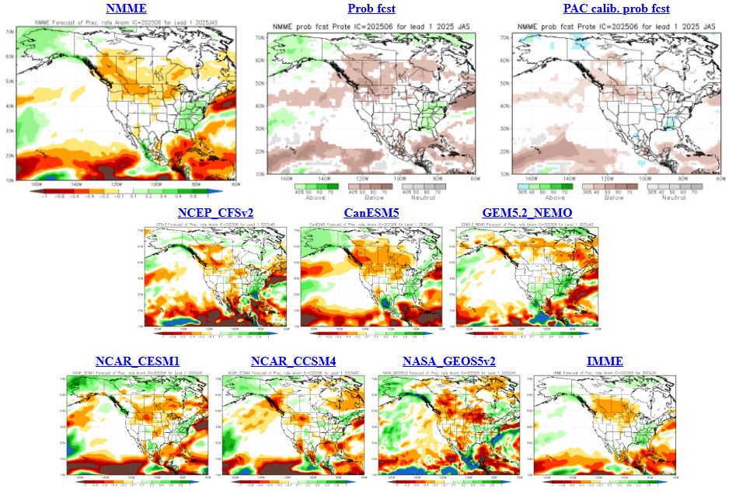
North American Multi-model Ensemble
JJA Precip
Many dry regions?
NMME – June run
Notes:
Temperature maps: blue = below normal, orange--red = above normal
Precipitation maps: orange--red = below normal, green = above normal
Seasonal forecasts produced by NRCan use temperature and precipitation from the two 10-member CanSIPS ensembles (green boxes in centre).
GEM-NEMO translates to Global Environmental Multiscale – Nucleus for European Modeling of the Oceans.
Wind data from these models have not been tested yet.
The remainder of the boxes show various models used in the NMME, with combined outputs condensed into the top left box, while
the bottom right box includes European models – the International Multi-Model Ensemble (IMME).

Slide 9
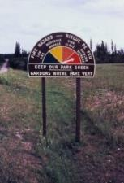
Canadian Forest Fire Weather Index (FWI) System
Seasonal forecasts use the severity rating anomaly
Fire Weather
Observations
Temperature
Humidity,
Wind, Rain
Temperature,
Humidity,
Rain
Snow depth
Barometric Pressure
Horizontal Visibility
Cloud cover and type
Upper air data
Wind
Temperature,
Rain
Fuel Moisture
Codes
FFMC
Fine Fuel Moisture Code
DMC
Duff Moisture Code
DC
Drought Code
Fire Behavior
Indexes
ISI
Initial Spread Index
BUI
Buildup Index
Fire Danger
FWI
Fire Weather Index
DSR/MSR/SSR
Severity Rating
Notes:
For the seasonal forecast maps, Monthly Severity Rating (MSR) forecasts are compared with a 30-year hindcast for respective months and locations to arrive at the anomalies. Seasonal forecast verification can be done by comparing forecast MSRs with observed values. Fire events can be used as a verification tool but this assumes ignitions have occurred where forecasts suggest high potential.
9

Slide 10
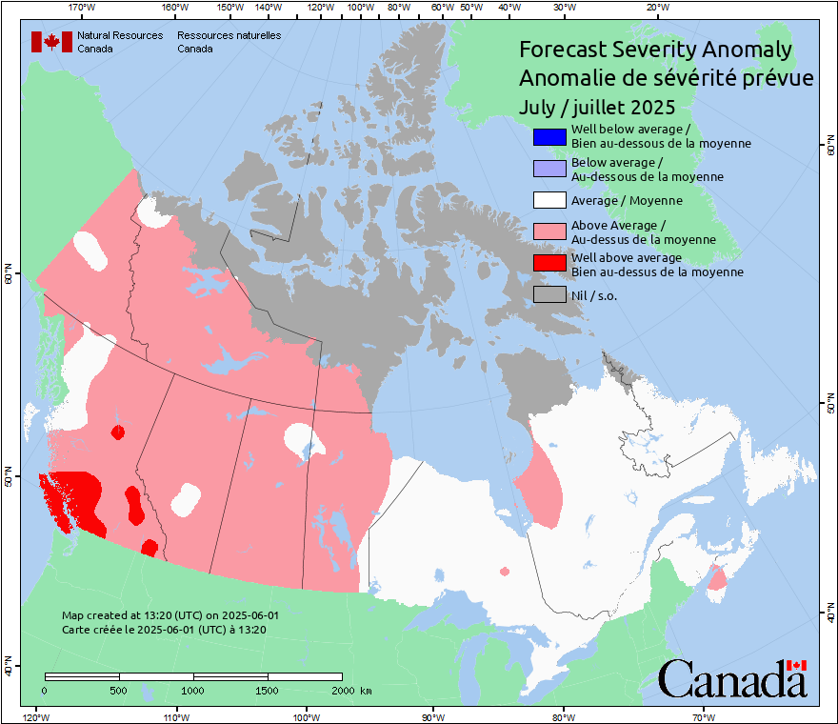
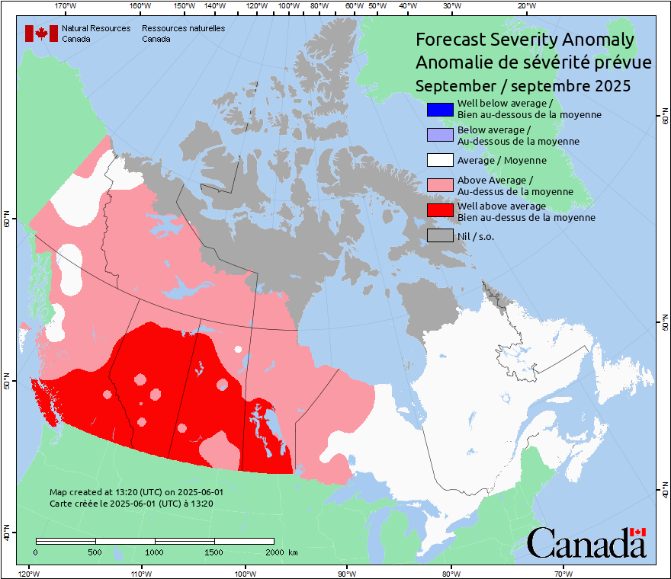
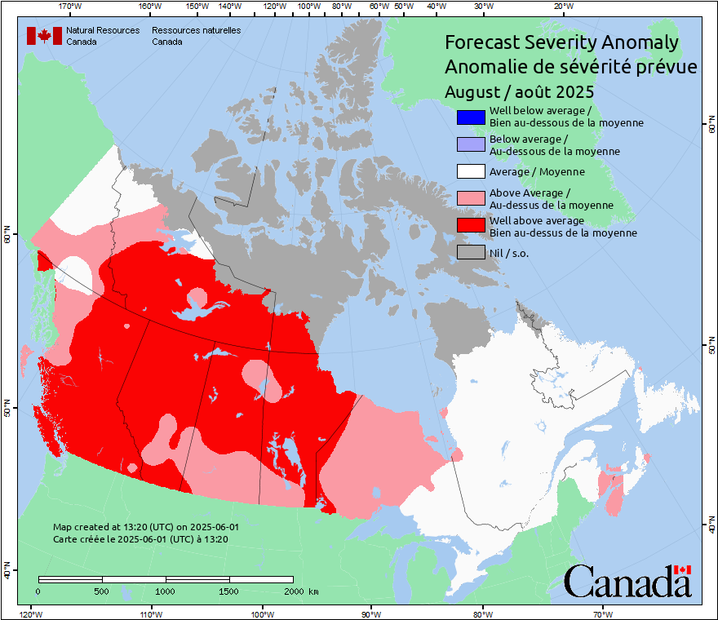
NRCan-CFS Prediction: June run, for July -- Sept
Anomaly
Predicted values normalized against average weather
Notes:
A patchy pattern likely indicates anomaly values lie close to the category bounds.
Although the southern Prairies are often red in the spring, little burning occurs due to greening of grass, so this area can often be ignored in mid-spring to early summer.
10

Slide 11
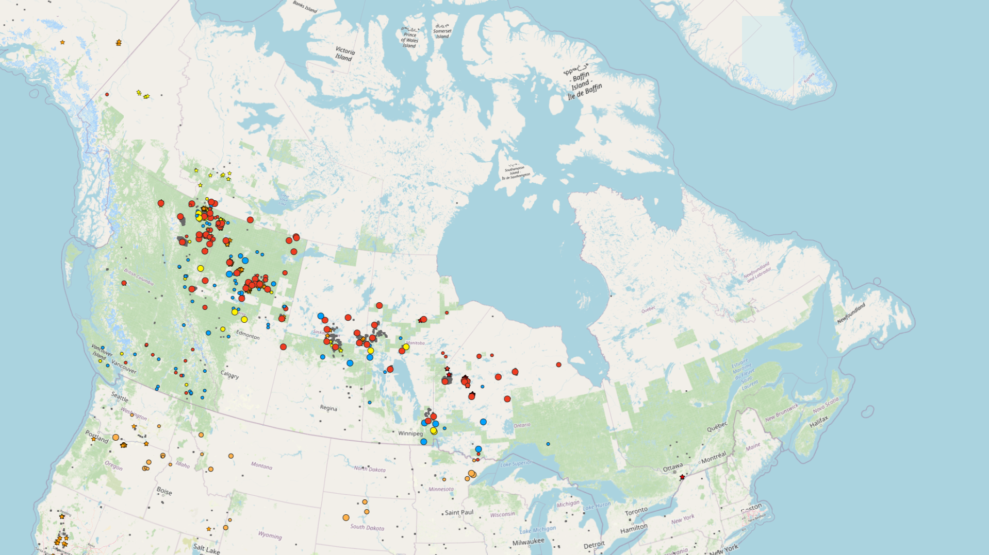
Windy spring?
Many periods of rapid growth
No wind comparisons with normals, but in discussion
Current burned area passed annual average by ~June 7
Area burned at about 3.5 million ha as of June 11
CIFFC National Preparedness Level at 5 since May 29, Level 3 since May 15
1 2 3 4 5
Crews from USA, Australia
Notes:
Map is from June 13
The National Preparedness Level is driven by P/T needs for firefighting resources. At Level 3, CIFFC/NRCan begin 4-week weather outlooks in evaluating need for international resource acquisition. At Level 5, all Canadian resources may be in use.
11

Slide 12
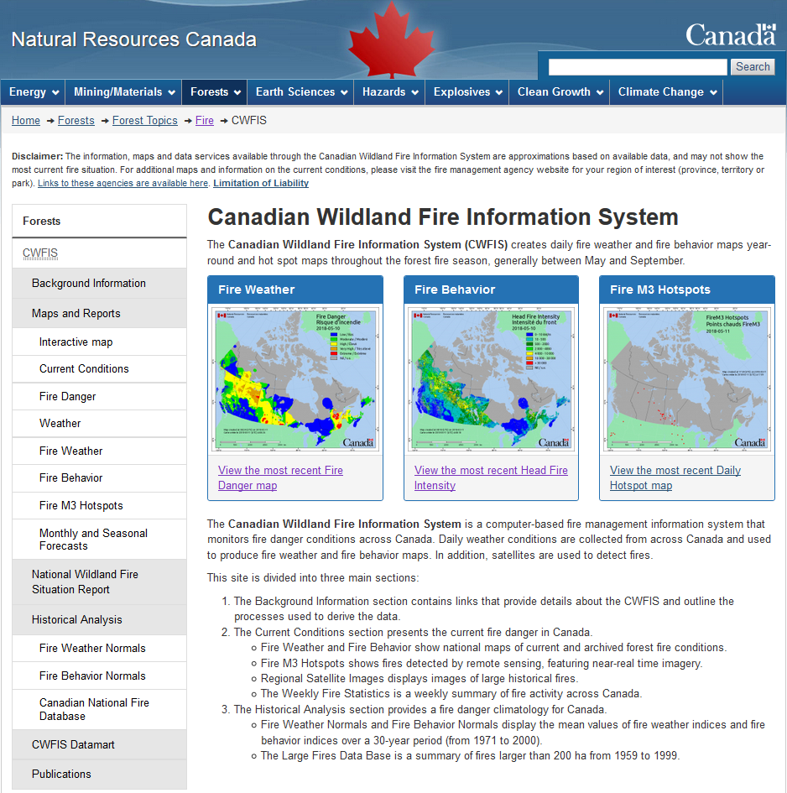
Canadian Wildland Fire Information System (CWFIS)
Note: updated CWFIS web site rollout 2025-26
Notes:
Highlights the Monthly and Seasonal Forecasts link on the CWFIS web page. This will eventually look different when the web site revisions are done! The new interactive map will feature a much larger choice of overlays. Many other new features will be introduced.

Slide 13
Conclusions and Reminders
Warm summer (may be common with warming climate)
Potentially dry, especially southern BC to central Canada
Neutral ENSO: higher activity in west?
Serious fires can occur in any year
Fire activity depends on ignitions; our forecast only predicts where potential exists
This year’s forecast runs have been produced using cleaned code on Azure (thank you, Robert Jagodzinski!)
In 2026 a new method will be introduced (Piyush Jain)

Slide 14
Remember to check updates …
Seasonal forecast: first working day each month on CWFIS: March-September
Daily conditions: provincial and/or CWFIS web sites
Government of Ontario

Slide 15
Questions?
Contact:
Richard Carr
Fire Research Analyst
Natural Resources Canada – Canadian Forest Service
Richard.Carr@NRCan-RNCan.gc.ca
5320 122 Street NW
Edmonton, AB, Canada
T6H 3S5
825-510-1265
?
?
?
?
?
Notes:
15

