Slide 1
Fire Season Severity Anomaly Forecast
May 15, 2025
Richard Carr
Natural Resources Canada – Canadian Forest Service

Slide 2
Agenda
2023-25 early season factors
Climate model predictions
2025 CWFIS Fire Season Forecast (May 1)

Slide 3
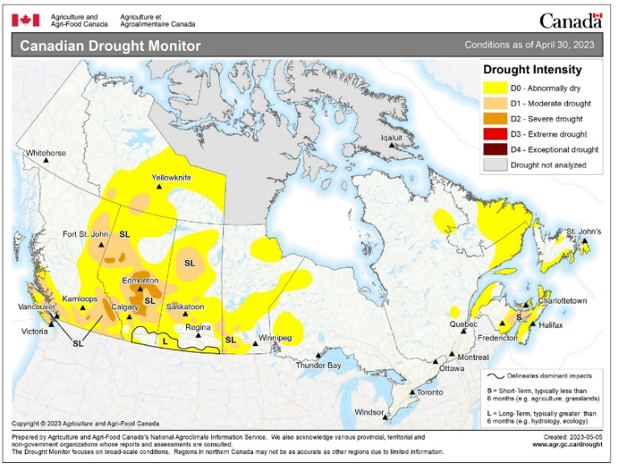
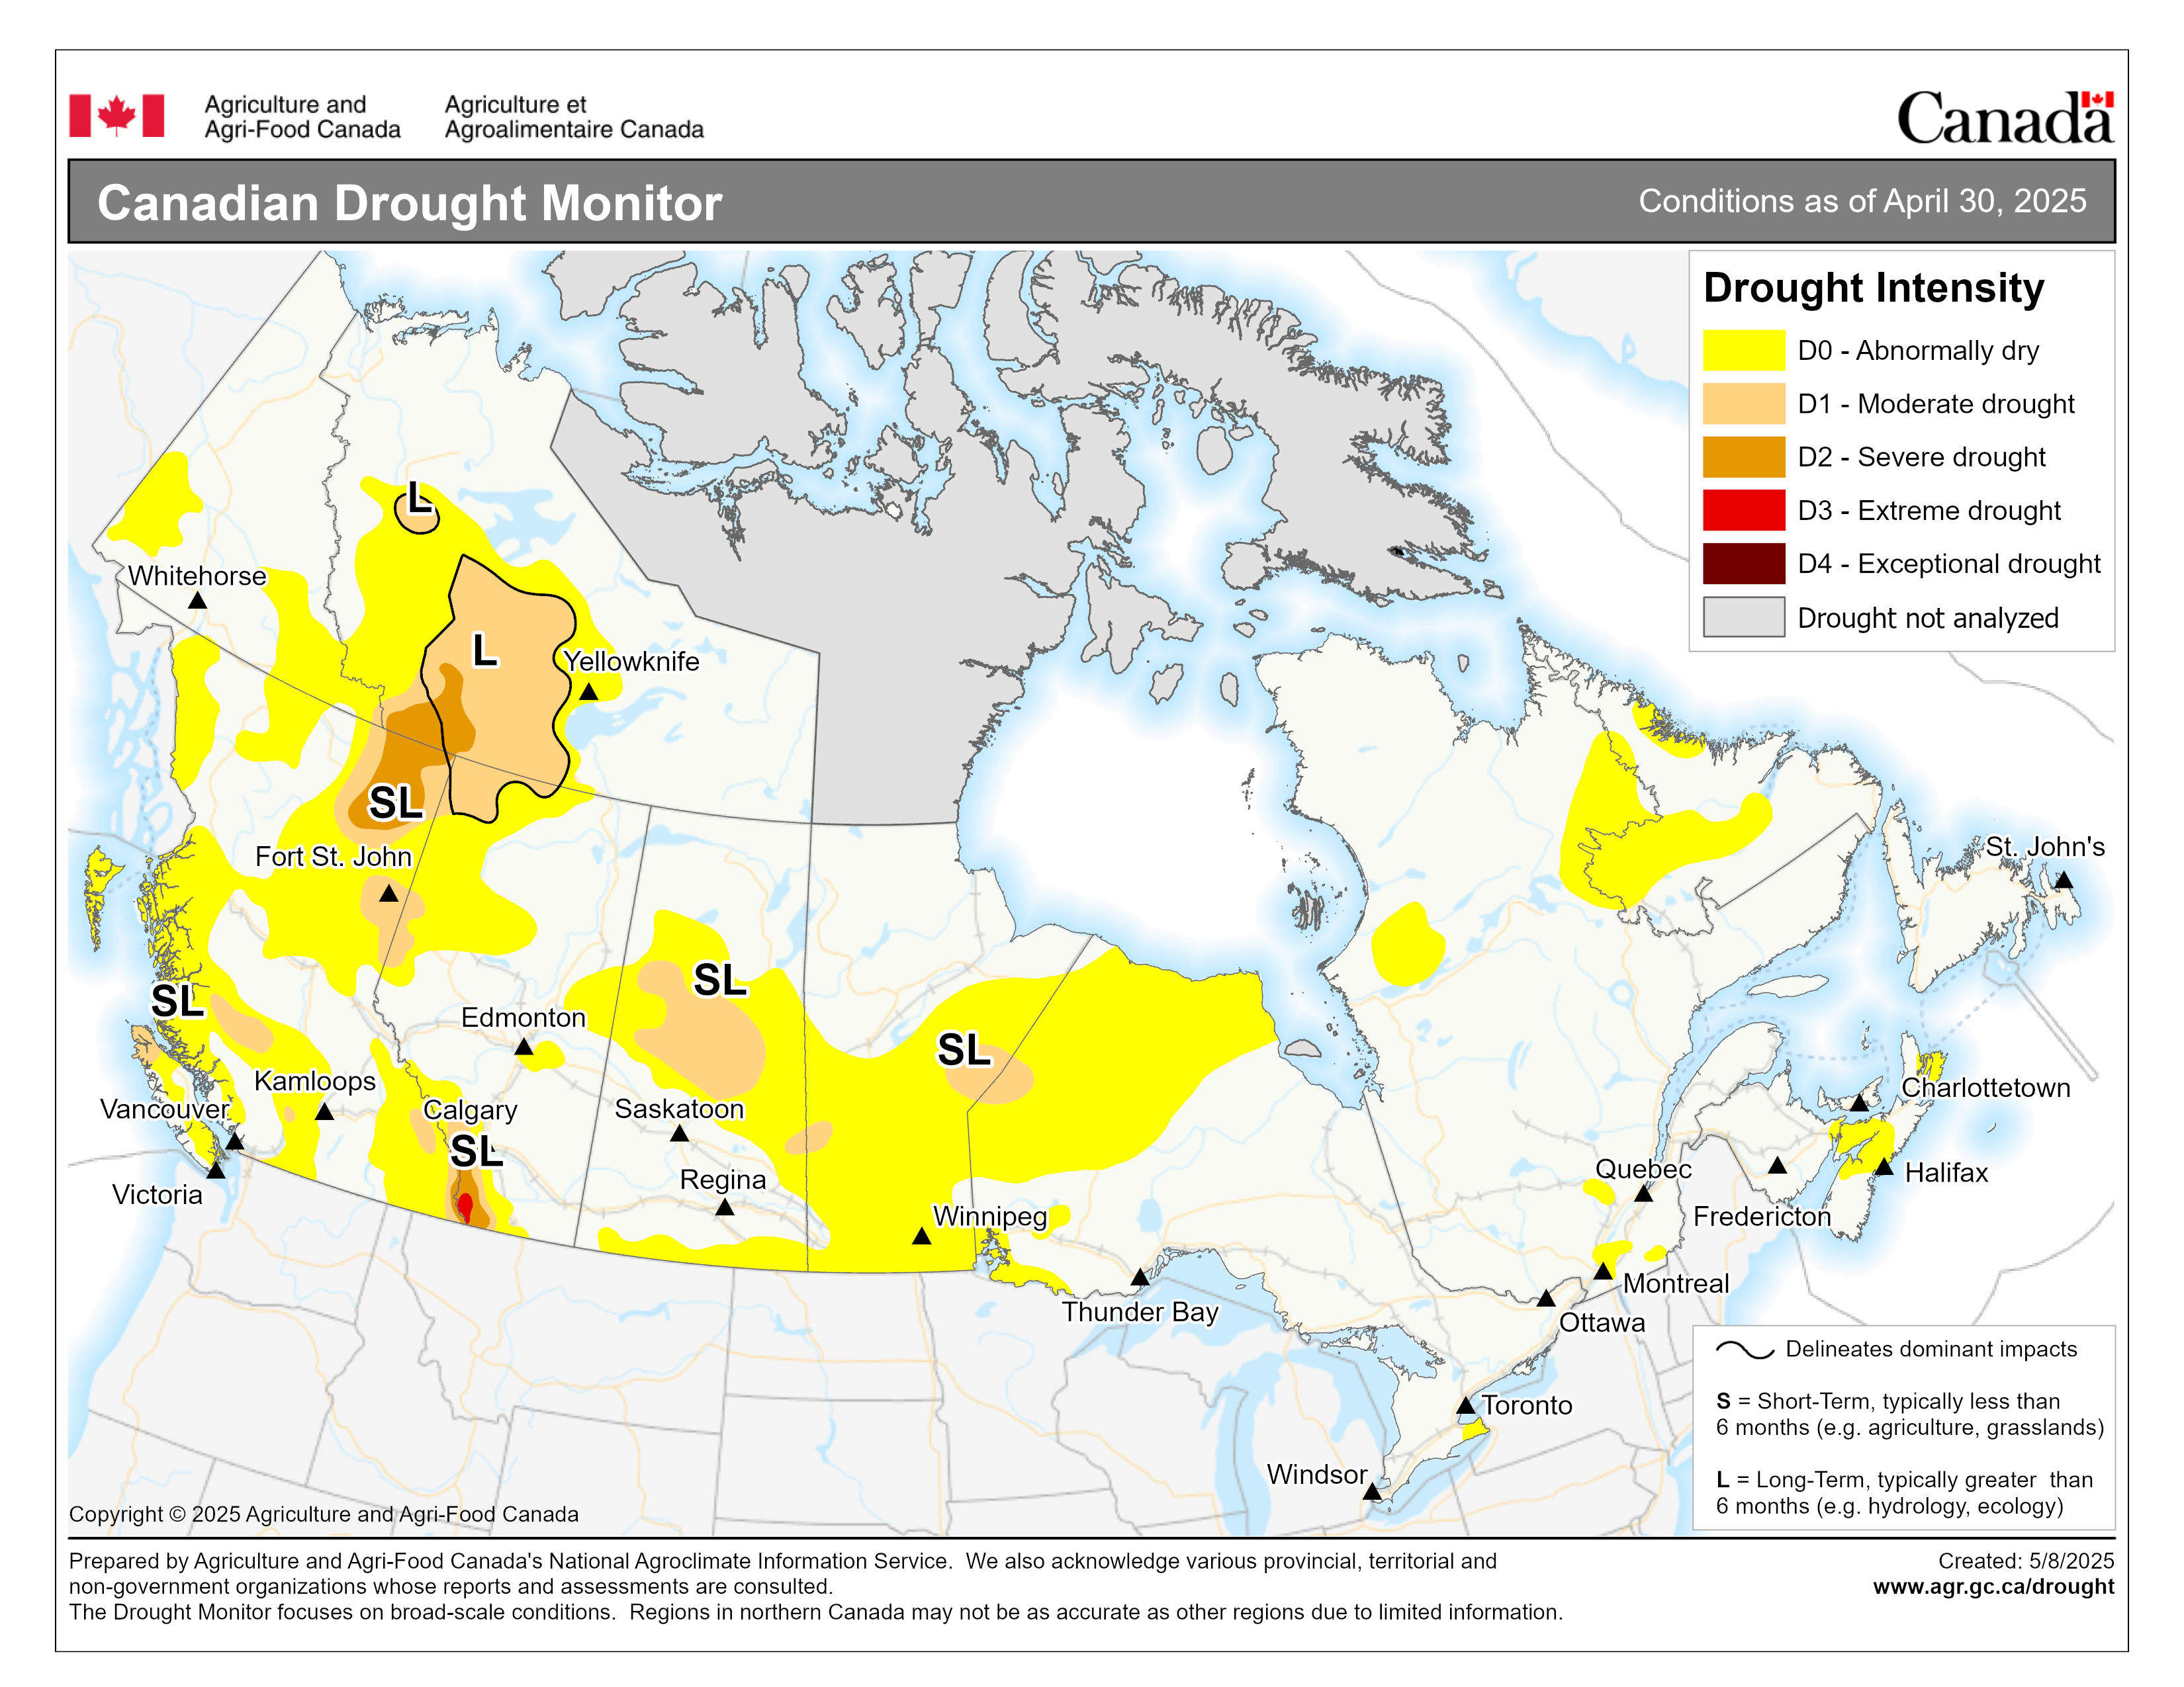
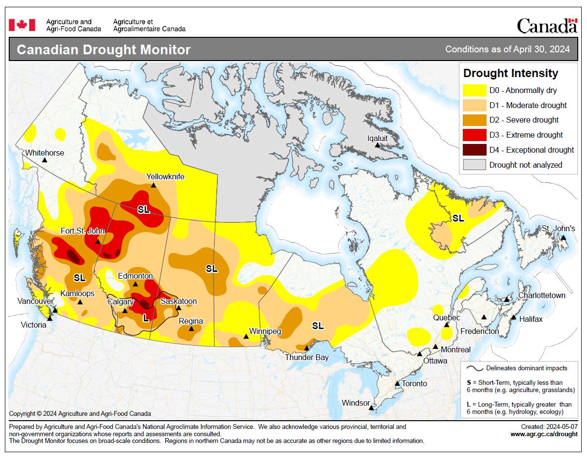
Drought Progression
Drought is less intense than in springs of 2023 and 2024
Minor changes this year from March 31 to April 30
Expansion likely in Saskatchewan during May
Notes:
3

Slide 4
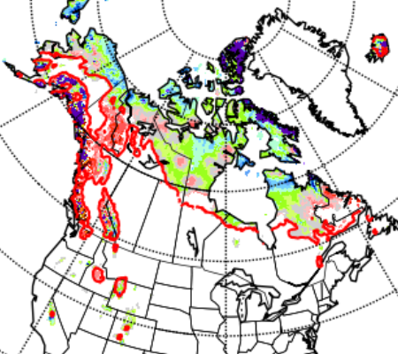

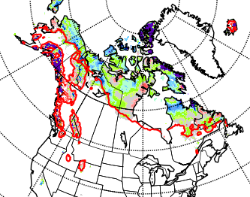
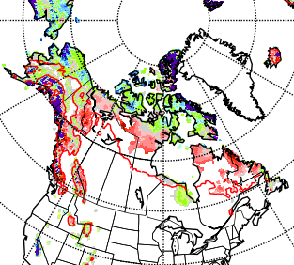
Snow Cover
Snow melted quickly in southern BC in February-March
Retreat of snow has been normal in recent weeks
May 10, 2023
May 8, 2024
May 14, 2025
Notes:
4

Slide 5
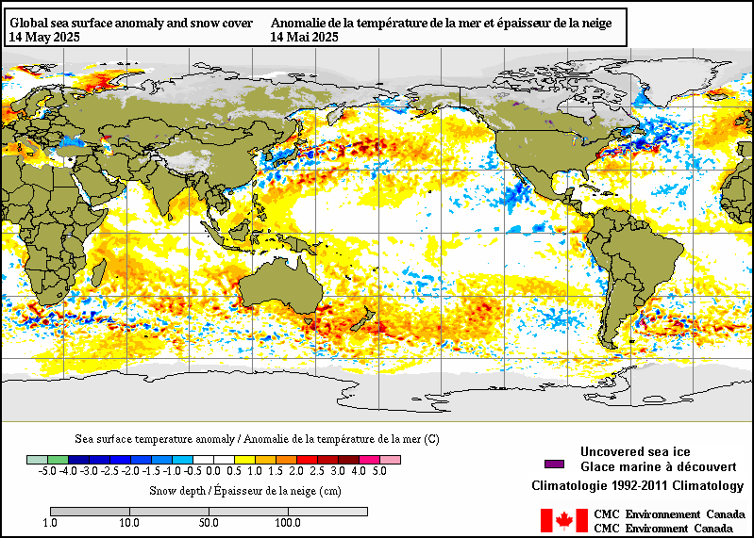
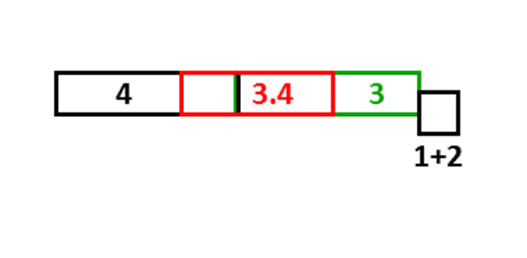
ENSO – Current SST
North Pacific SST (PDO) closer to neutral than past few years
La Niña-ish condition faded … was our winter ever a true La Niña?
Notes:
Sea surface temperatures (SST): blue = below normal, orange--red = above normal.
Blue in the boxes along the equator indicate La Nina is likely developing (ENSO SST indexes are measured in the red box).
SST in the red ellipse can indicate status of the Pacific Decadal Oscillation (PDO). Cold water along the BC coast with warm water in the central north Pacific indicate the PDO is in the negative phase. Some of the big fire years in northern parts of the provinces and Territories have occurred with a positive PDO, opposite phase from what we currently see.
North Atlantic waters have cooled from late 2023. Note this may not indicate phase of the North Atlantic Oscillation, which is determined by the strength of the Icelandic low
pressure and the Azores high pressure systems.
5

Slide 6
Fire Problems in ENSO Springs
El Niño:
Warm, windy, dry in western Canada
La Niña:
Arctic surface highs bring dry air, strong wind around edges
Temperature may be cool
Summer fire problems may depend on other influences
Year | DJF | JFM | FMA | MAM | AMJ | MJJ | JJA | JAS | ASO | SON | OND | NDJ
1995 | 1.0 | 0.7 | 0.5 | 0.3 | 0.1 | 0.0 | -0.2 | -0.5 | -0.8 | -1.0 | -1.0 | -1.0
1998 | 2.2 | 1.9 | 1.4 | 1.0 | 0.5 | -0.1 | -0.8 | -1.1 | -1.3 | -1.4 | -1.5 | -1.6
1999 | -1.5 | -1.3 | -1.1 | -1.0 | -1.0 | -1.0 | -1.1 | -1.1 | -1.2 | -1.3 | -1.5 | -1.7
2000 | -1.7 | -1.4 | -1.1 | -0.8 | -0.7 | -0.6 | -0.6 | -0.5 | -0.5 | -0.6 | -0.7 | -0.7
2001 | -0.7 | -0.5 | -0.4 | -0.3 | -0.3 | -0.1 | -0.1 | -0.1 | -0.2 | -0.3 | -0.3 | -0.3
2002 | -0.1 | 0.0 | 0.1 | 0.2 | 0.4 | 0.7 | 0.8 | 0.9 | 1.0 | 1.2 | 1.3 | 1.1
2003 | 0.9 | 0.6 | 0.4 | 0.0 | -0.3 | -0.2 | 0.1 | 0.2 | 0.3 | 0.3 | 0.4 | 0.4
2004 | 0.4 | 0.3 | 0.2 | 0.2 | 0.2 | 0.3 | 0.5 | 0.6 | 0.7 | 0.7 | 0.7 | 0.7
2005 | 0.6 | 0.6 | 0.4 | 0.4 | 0.3 | 0.1 | -0.1 | -0.1 | -0.1 | -0.3 | -0.6 | -0.8
2006 | -0.8 | -0.7 | -0.5 | -0.3 | 0.0 | 0.0 | 0.1 | 0.3 | 0.5 | 0.7 | 0.9 | 0.9
2007 | 0.7 | 0.3 | 0.0 | -0.2 | -0.3 | -0.4 | -0.5 | -0.8 | -1.1 | -1.4 | -1.5 | -1.6
2008 | -1.6 | -1.4 | -1.2 | -0.9 | -0.8 | -0.5 | -0.4 | -0.3 | -0.3 | -0.4 | -0.6 | -0.7
2009 | -0.8 | -0.7 | -0.5 | -0.2 | 0.1 | 0.4 | 0.5 | 0.5 | 0.7 | 1.0 | 1.3 | 1.6
2010 | 1.5 | 1.3 | 0.9 | 0.4 | -0.1 | -0.6 | -1.0 | -1.4 | -1.6 | -1.7 | -1.7 | -1.6
2011 | -1.4 | -1.1 | -0.8 | -0.6 | -0.5 | -0.4 | -0.5 | -0.7 | -0.9 | -1.1 | -1.1 | -1.0
2012 | -0.8 | -0.6 | -0.5 | -0.4 | -0.2 | 0.1 | 0.3 | 0.3 | 0.3 | 0.2 | 0.0 | -0.2
2013 | -0.4 | -0.3 | -0.2 | -0.2 | -0.3 | -0.3 | -0.4 | -0.4 | -0.3 | -0.2 | -0.2 | -0.3
2014 | -0.4 | -0.4 | -0.2 | 0.1 | 0.3 | 0.2 | 0.1 | 0.0 | 0.2 | 0.4 | 0.6 | 0.7
2015 | 0.6 | 0.6 | 0.6 | 0.8 | 1.0 | 1.2 | 1.5 | 1.8 | 2.1 | 2.4 | 2.5 | 2.6
2016 | 2.5 | 2.2 | 1.7 | 1.0 | 0.5 | 0.0 | -0.3 | -0.6 | -0.7 | -0.7 | -0.7 | -0.6
2017 | -0.3 | -0.1 | 0.1 | 0.3 | 0.4 | 0.4 | 0.2 | -0.1 | -0.4 | -0.7 | -0.9 | -1.0
2018 | -0.9 | -0.8 | -0.6 | -0.4 | -0.1 | 0.1 | 0.1 | 0.2 | 0.4 | 0.7 | 0.9 | 0.8
2019 | 0.7 | 0.7 | 0.7 | 0.7 | 0.5 | 0.5 | 0.3 | 0.1 | 0.2 | 0.3 | 0.5 | 0.5
2020 | 0.5 | 0.5 | 0.4 | 0.2 | -0.1 | -0.3 | -0.4 | -0.6 | -0.9 | -1.2 | -1.3 | -1.2
2021 | -1.0 | -0.9 | -0.8 | -0.7 | -0.5 | -0.4 | -0.4 | -0.5 | -0.7 | -0.8 | -1.0 | -1.0
2022 | -1.0 | -0.9 | -1.0 | -1.1 | -1.0 | -0.9 | -0.8 | -0.9 | -1.0 | -1.0 | -0.9 | -0.8
2023 | -0.7 | -0.4 | -0.1 | 0.2 | 0.5 | 0.8 | 1.1 | 1.3 | 1.6 | 1.8 | 1.9 | 2.0
2024 | 1.8 | 1.5 | 1.1 | 0.7 | 0.4 | 0.2 | 0.0 | -0.1 | -0.2 | -0.3 | -0.4 | -0.5
2025 | -0.6 | -0.4 | -0.2
Large area burned
Virginia Hills, AB
Chisholm, AB
Kelowna, BC
Slave Lake, AB
PDO positive phase
Fort McMurray, AB
Big years in BC
Western half
Most of Canada!
Busy summer

Slide 7
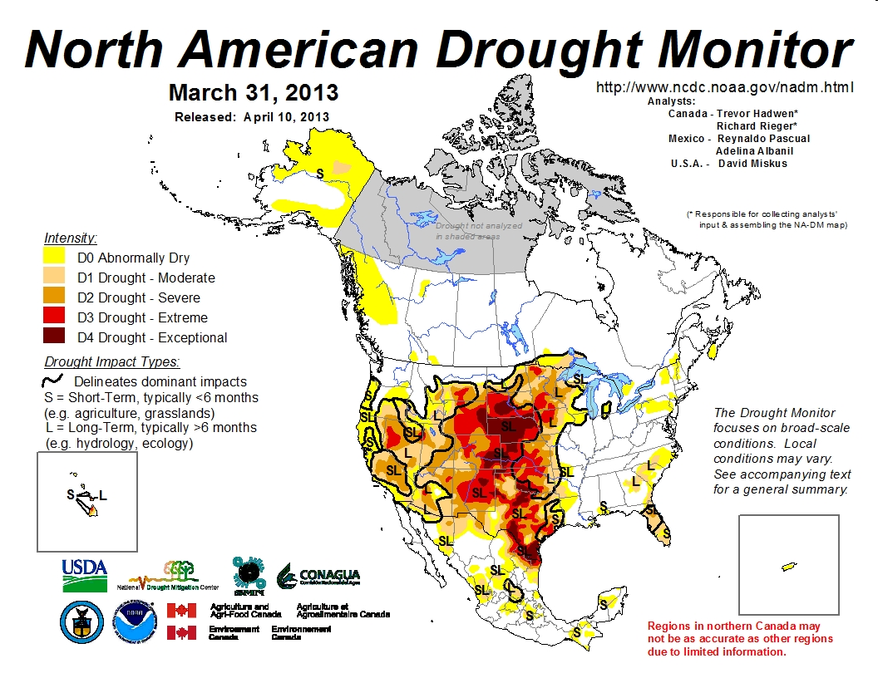
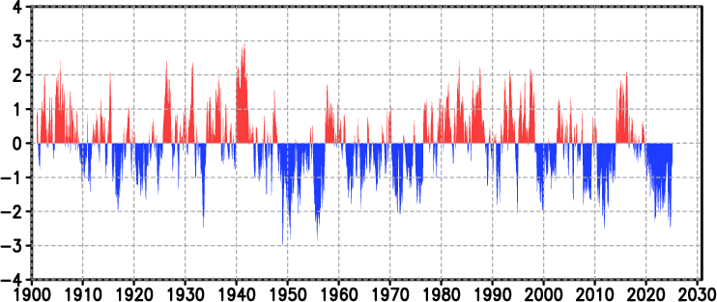
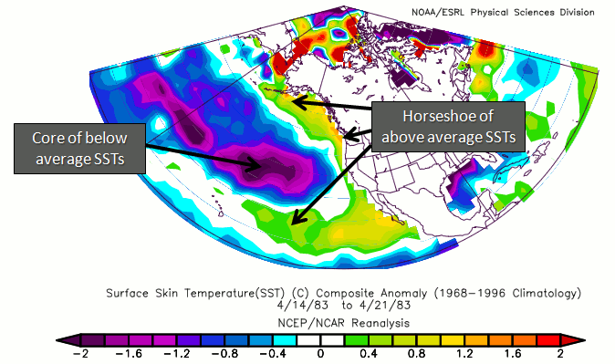
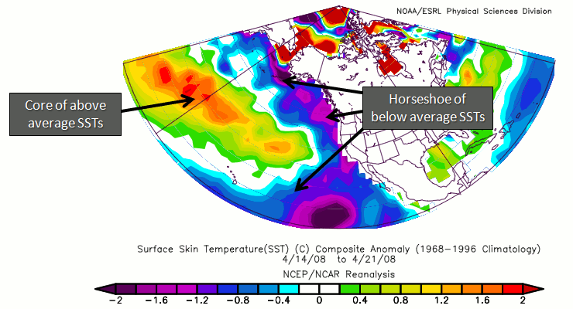
Pacific Decadal Oscillation (as of Mar 2025)
https://ds.data.jma.go.jp/tcc/tcc/products/elnino/decadal/pdo_month.html
Warm phase
Cold phase
http://climate.ncsu.edu/climate/patterns/PDO.html
Notes:
7

Slide 8
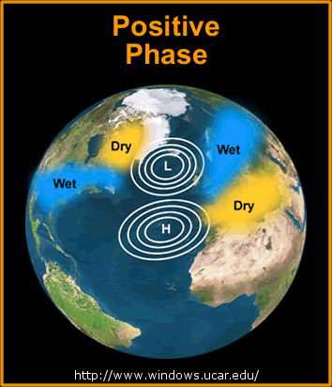
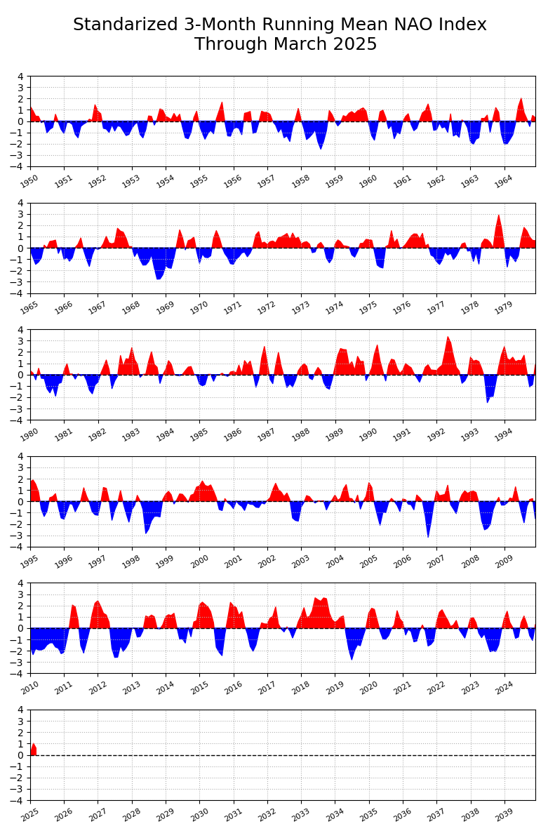
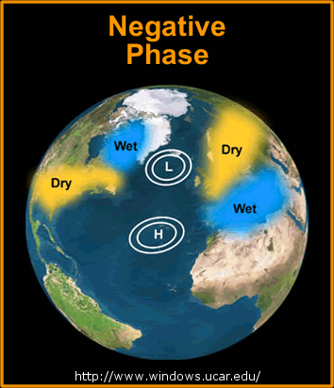
North Atlantic Oscillation (to Mar 2025)
https://www.ncei.noaa.gov/access/monitoring/nao
+
Quebec Area Burned
(NFDB, ha*1000)
2023 5000*
2015 5
2013 1900
2010 315
2008 1
2007 343
2005 800
2004 3
2002 1000
-
Early years may not include area burned in northern (unmanaged) region
-
+
Notes:
Years with high burned area in Quebec are indicated in black text, moderate years in orange, and low in green. Perhaps the degree to which the NAO is positive influences fire occurrence,
which depends on the correct dryness (high atmospheric pressure) coupled with enough atmospheric instability to generate thundershowers, or increased human activity in the absence of rain. This may occur during years where the NAO transitions between negative and positive or vice versa.
A study ongoing at Universite du Quebec a Montreal will likely provide more insight into oceanic/atmospheric oscillations that influence fire in eastern Canada. One finding may link a Baffin/West Atlantic (BWA) oscillation with increased severity rating (I have not read outcomes from this study so can’t comment on this any more at this time).
8

Slide 9
Climate Model Predictions
Notes:
9

Slide 10
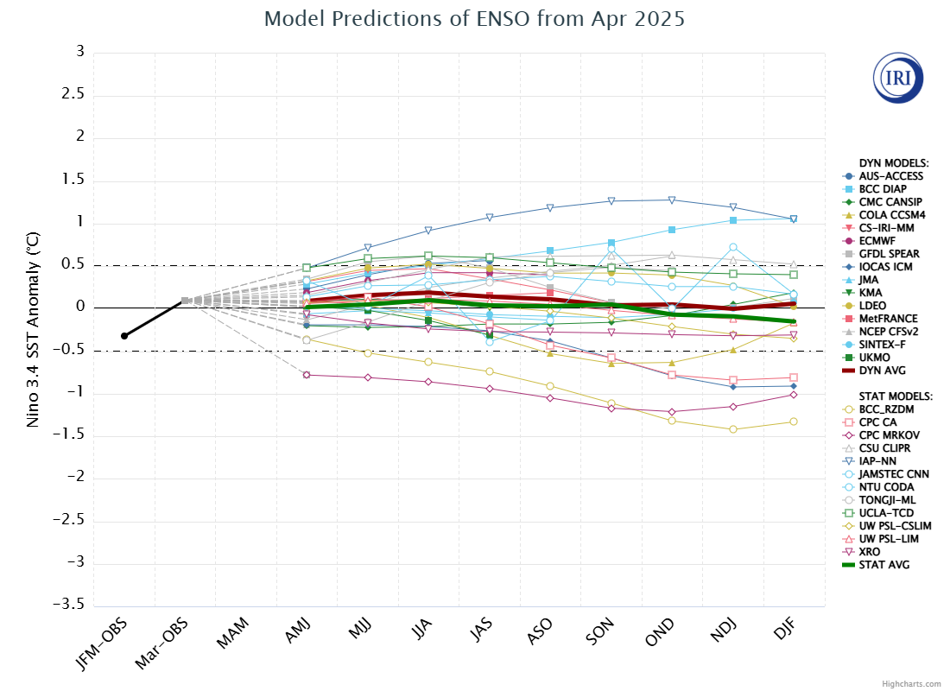
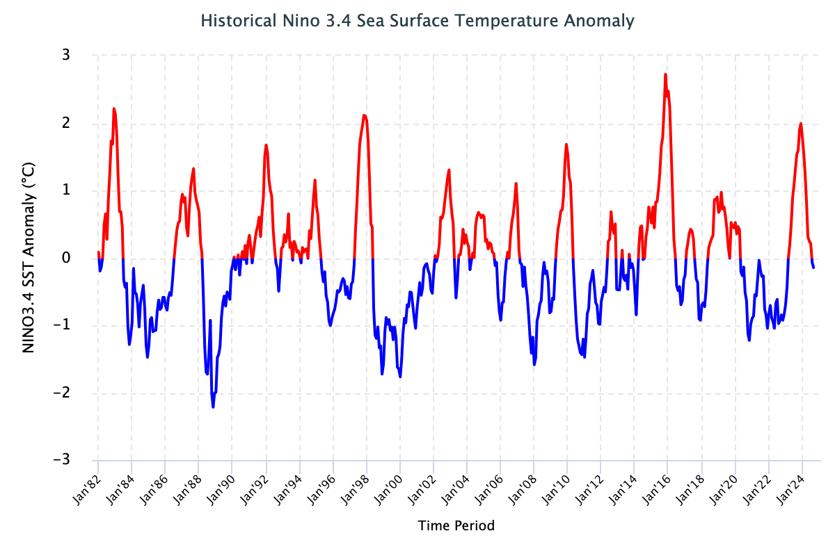
IRI ENSO Forecast
https://iri.columbia.edu/our-expertise/climate/forecasts/enso/current/?enso_tab=enso-sst_table
https://iri.columbia.edu/our-expertise/climate/forecasts/enso/2024-october-quick-look/?enso_tab=enso-sst_image
Neutral conditions likely continuing 0ver summer
April, 2025
Time series to October 2024
Notes:
Neutral ENSO is when indexes remain between the horizontal red lines on the plume chart and the black lines on the time series.
El Nino occurs when the indexes are above the top line (+0.5 sea surface temperature anomaly in the 3.4 region) for over 3 consecutive months.
La Nina occurs when the indexes are below the bottom line (-0.5 sea surface temperature anomaly in the 3.4 region) for over 3 consecutive months.
10

Slide 11
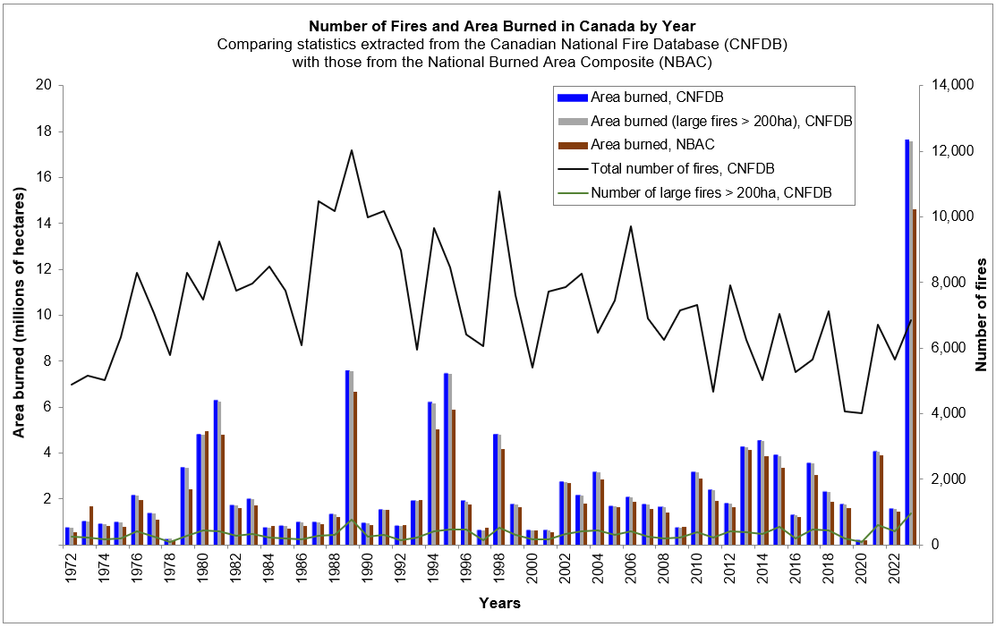
Neutral ENSO: Recent Analog Years
Arrows to area burned: 2012 (orange), 2013—2014, 2017 (black), 2020 (green), 2024 (black)
2024
Notes:
Dominant neutral: greater than 6 months in neutral phase
Other years featured short neutral summer periods (2016, 2018, 2021)
11

Slide 12
CanSIPS
Ensemble has increased from 2x10 to 2x20 members
Models developed by Canadian Centre for Climate Modeling and Analysis
CanCM4i (CanESM5)
GEM5.2-NEMO: Global Environmental Multiscale – Nucleus for European Modeling of the Ocean
NRCan uses temperature and precipitation data, plus fuel moisture initialization from CWFIS
Skill of climate forecasts often best in coastal areas, poorer in lee of mountain ranges
Notes:
12

Slide 13
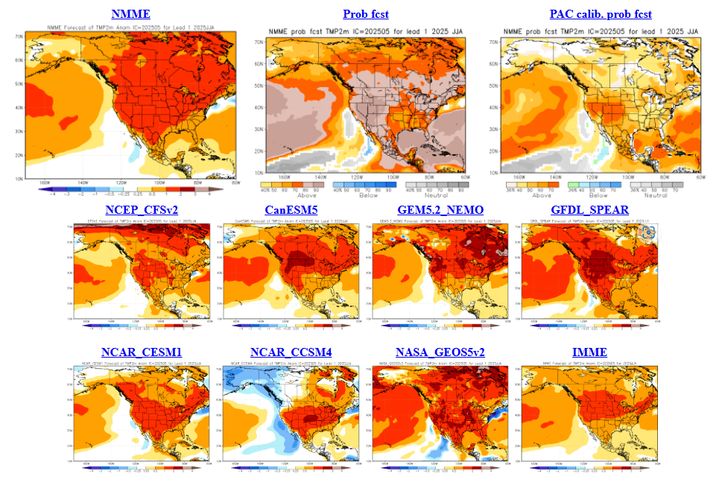
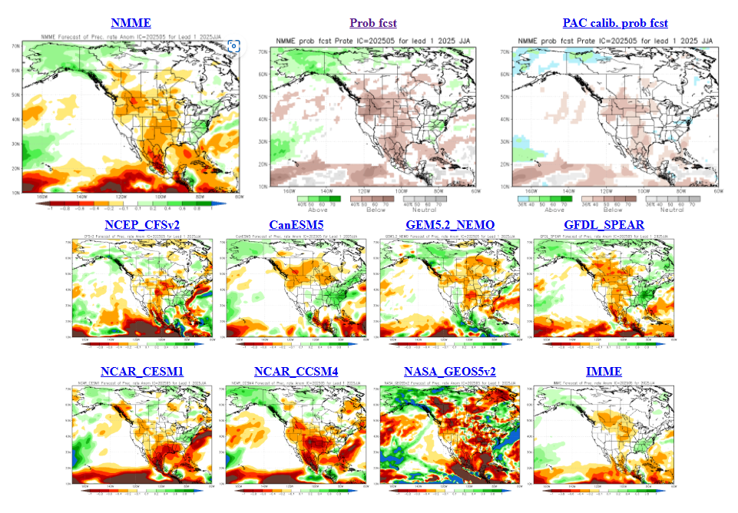
North American Multi-model Ensemble
NMME – April run
JJA Temp
Looks warm …
Subtract a bit of drama to get truer picture!
JJA Precip
Many dry regions?
Notes:
Temperature maps: blue = below normal, orange--red = above normal
Precipitation maps: orange--red = below normal, green = above normal
Seasonal forecasts produced by NRCan use temperature and precipitation from the two 10-member CanSIPS ensembles (green boxes in centre).
GEM-NEMO translates to Global Environmental Multiscale – Nucleus for European Modeling of the Oceans.
Wind data from these models have not been tested yet.
The remainder of the boxes show various models used in the NMME, with combined outputs condensed into the top left box, while
the bottom right box includes European models – the International Multi-Model Ensemble (IMME).

Slide 14
2025 NRCan-CFS Seasonal Prediction
Notes:
14

Slide 15
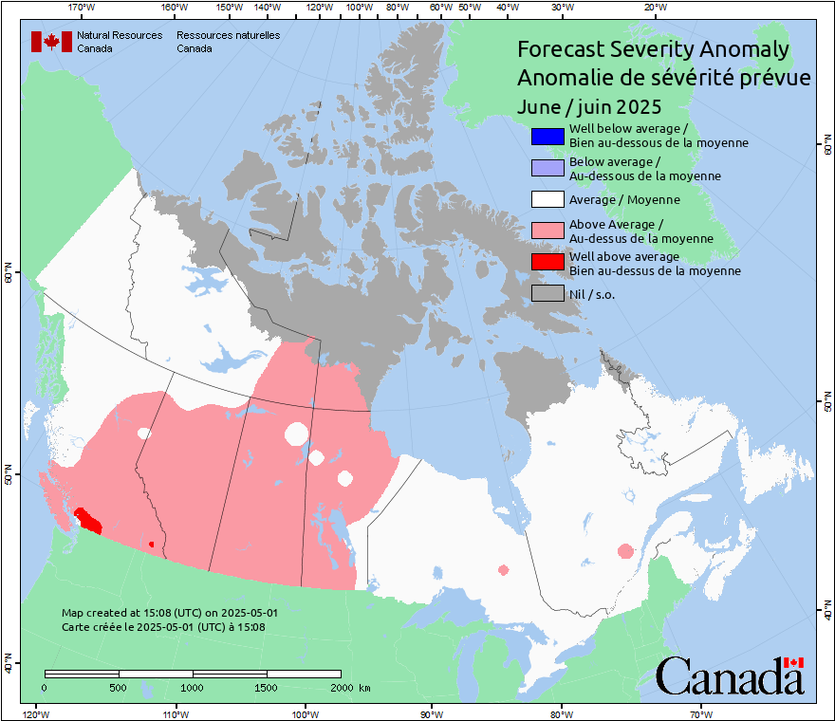
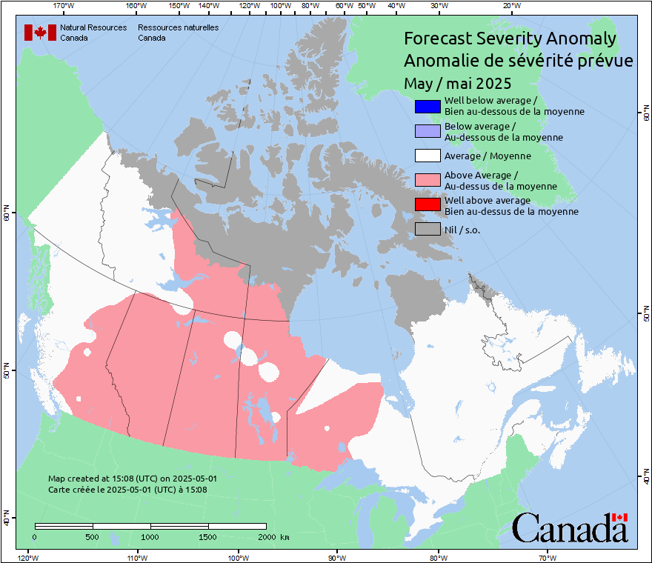
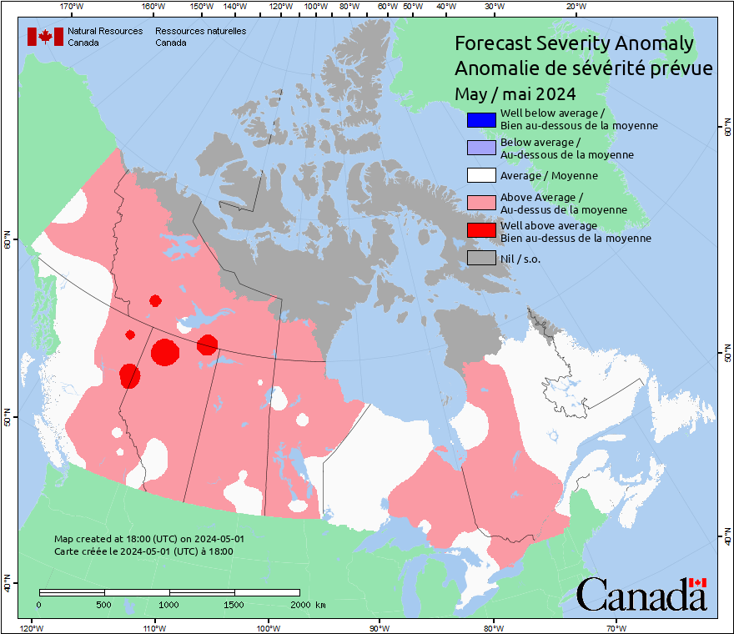
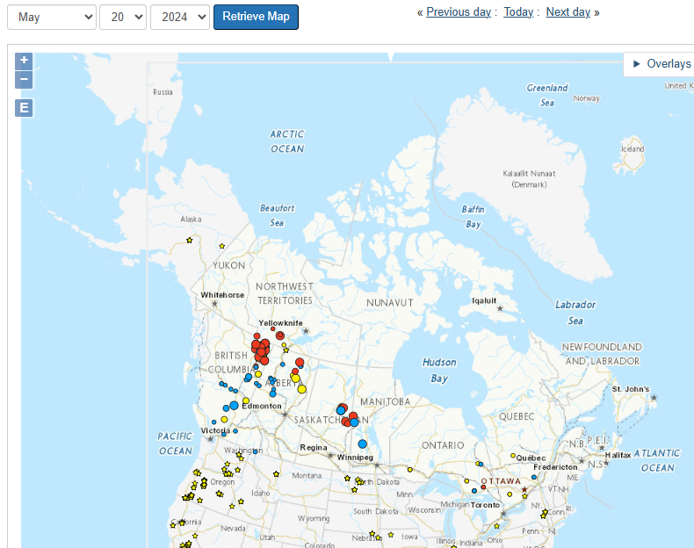
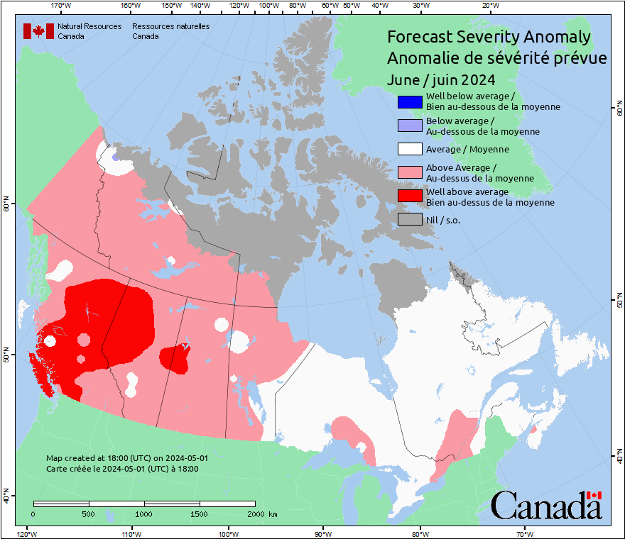
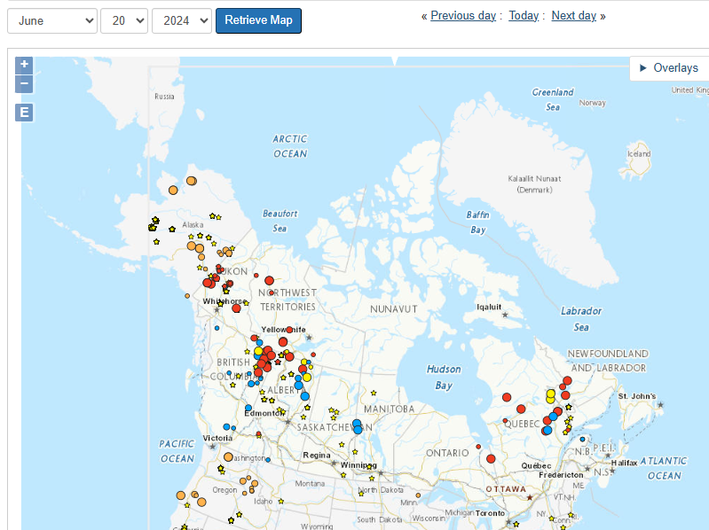
NRCan-CFS Prediction: May run, for May/June
Anomaly
Predicted values normalized against average weather
Notes:
A patchy pattern likely indicates anomaly values lie close to the category bounds.
Although the southern Prairies are often red in the spring, little burning occurs due to greening of grass, so this area can often be ignored in mid to late spring.
15

Slide 16
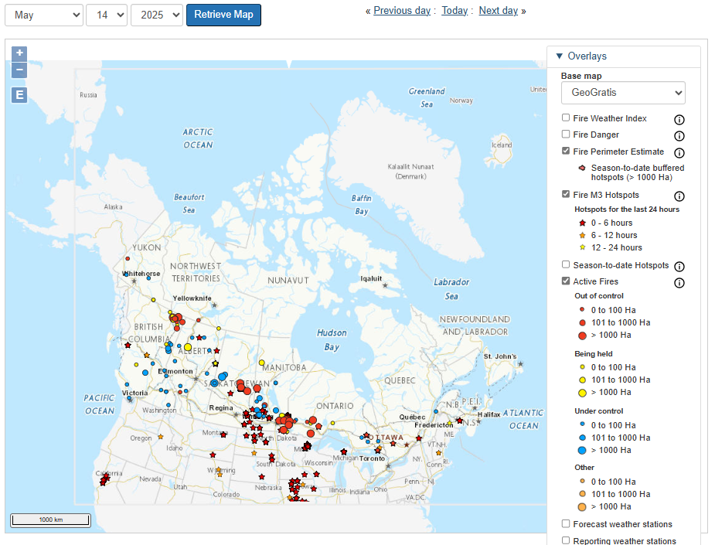
CWFIS Current Season Snapshot
CWFIS: Canadian Wildland Fire Information System: https://cwfis.cfs.nrcan.gc.ca
Large spring fires BC to western Ontario
Notes:
16

Slide 17
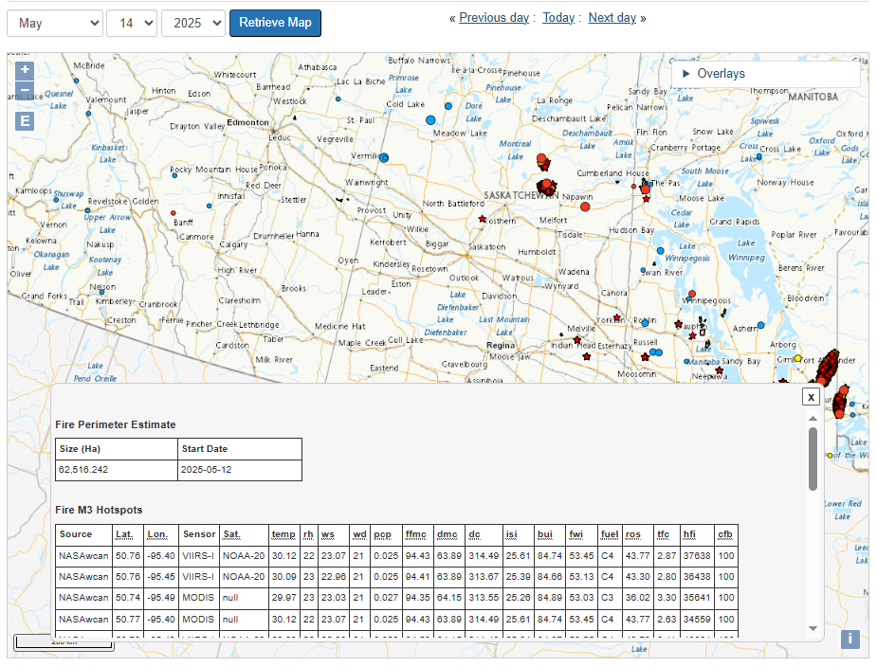
CWFIS Interactive Map Information
Windy and dry spring: rapid fire growth over the past few days
On the CWFIS interactive map, click features to open and information box
Notes:
17

Slide 18
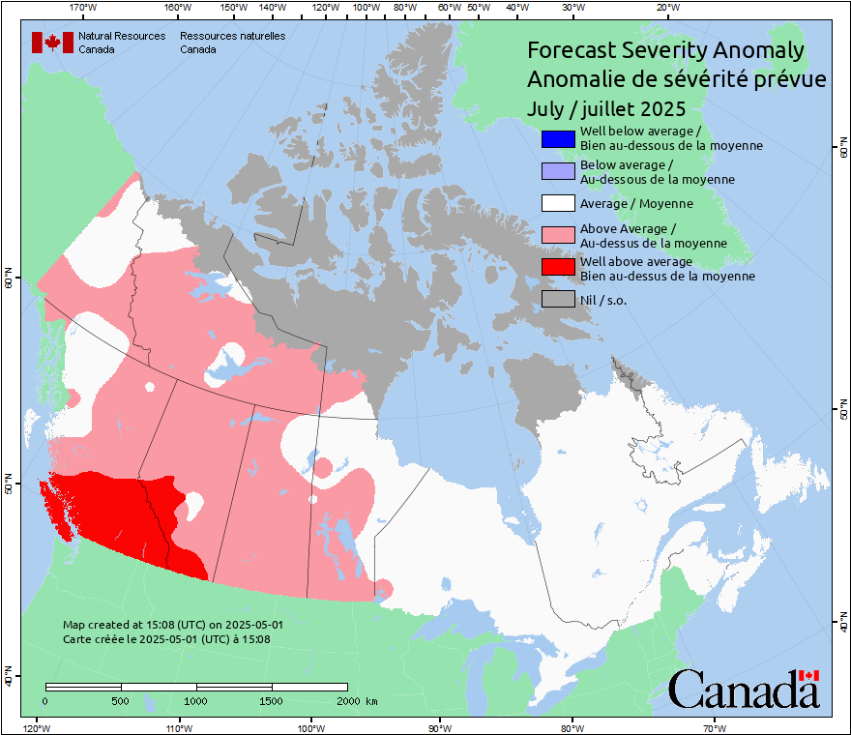
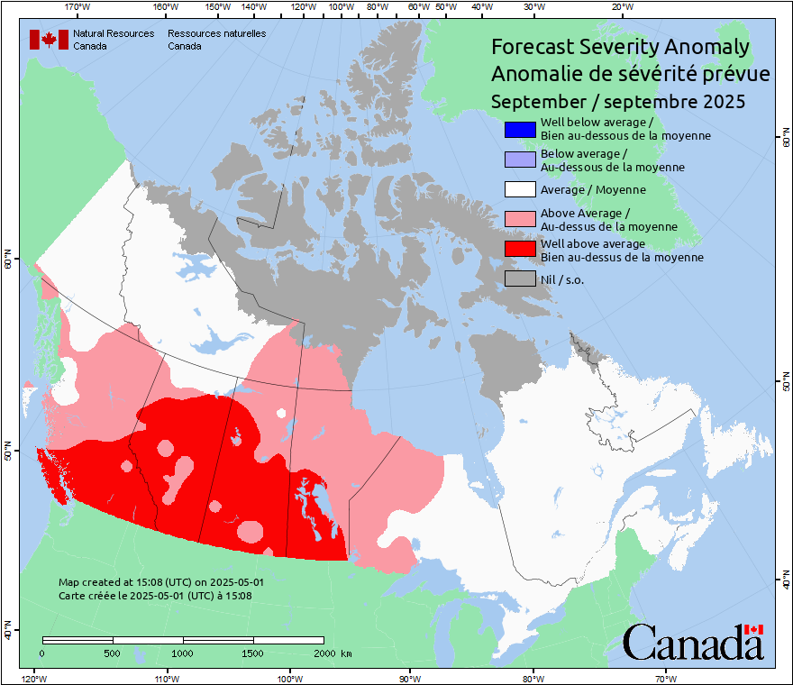
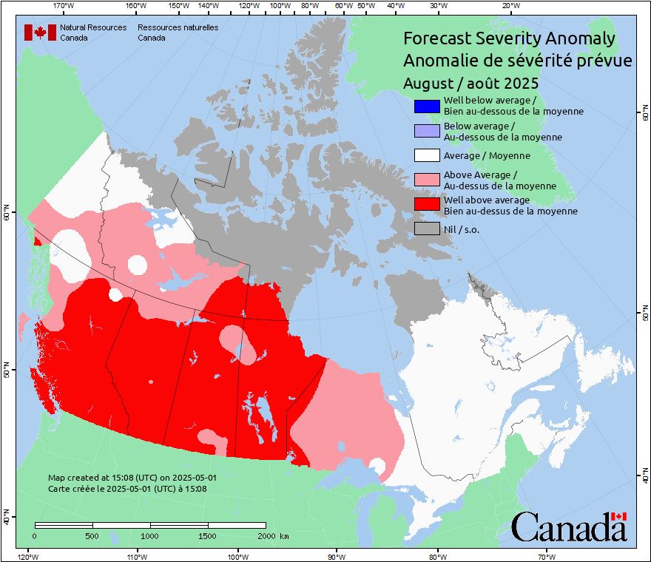
NRCan-CFS Prediction: May run, for July-Sept
Anomaly
Predicted values normalized against average weather
Notes:
A patchy pattern likely indicates anomaly values lie close to the category bounds.
18

Slide 19

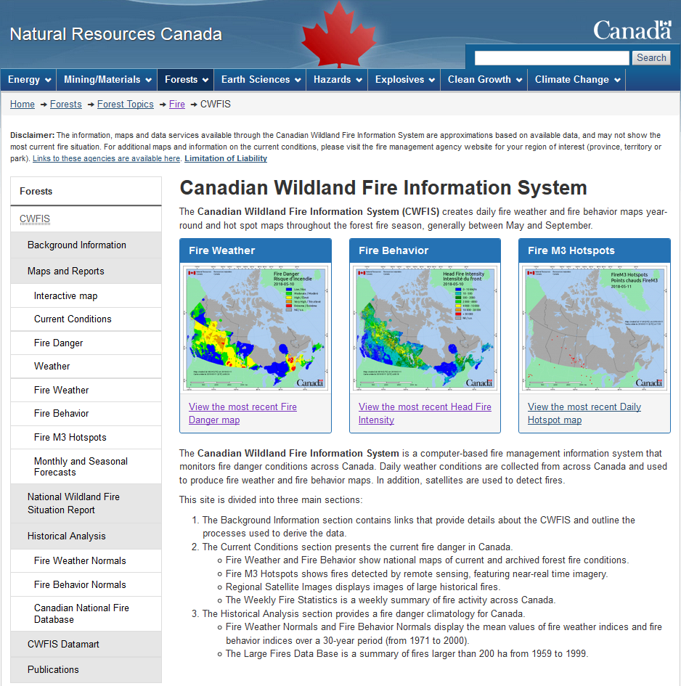
Canadian Wildland Fire Information System (CWFIS)
Note: updated CWFIS web site rollout during 2025
Notes:
Highlights the Monthly and Seasonal Forecasts link on the CWFIS web page. This will eventually look different when the web site revisions are done!

Slide 20
Conclusions and Reminders
Warm summer (may be common with warming climate)
Potentially dry, especially southern BC to central Canada
Neutral ENSO: higher activity in west?
Serious fires can occur in any year
Fire activity depends on ignitions; our forecast only predicts where potential exists
This year’s forecast runs have been produced using cleaned code on Azure (thank you, Robert Jagodzinski!)
In 2026 we may utilize a new methodology (Piyush Jain)

Slide 21
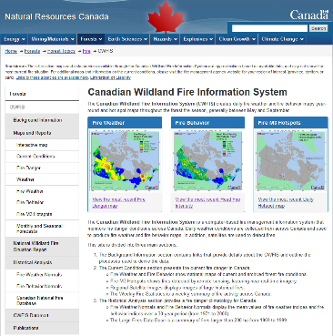











Remember to check updates …
Seasonal forecast: first working day each month on CWFIS
Daily conditions: provincial and/or CWFIS web sites
Government of Ontario

Slide 22
Questions?
Contact:
Richard Carr
Fire Research Analyst
Natural Resources Canada – Canadian Forest Service
Richard.Carr@NRCan-RNCan.gc.ca
5320 122 Street NW
Edmonton, AB, Canada
T6H 3S5
825-510-1265
?
?
?
?
?
Notes:
22

